Slide 1






2024 Benefits Enrollment Overview
For LiUNA Bargaining Unit Members
Notes:
Welcome to the 2023 annual enrollment presentation for LiUNA bargaining unit members.
The purpose of today’s meeting is to provide you with an overview of the benefits JHU will offer in 2024, and the tools and resources that you can use to help you choose your benefits.

Slide 2

Today We’ll Discuss
Benefits enrollment overview
What’s new for 2024?
More about your JHU benefits
Actions needed
Where to learn more and get help
Questions?
Benefits Enrollment is October 11–31, 2023

Slide 3






Benefits Enrollment Is October 11–31, 2023
Medical
Dental
Vision
Tax-advantaged accounts
Life insurance
and disability coverage
And
more!
Notes:
Benefits enrollment is your once-a-year opportunity to elect certain benefits (except for when you experience a life event, like getting married, adding a child to your family, or when a spouse or partner loses their job).
During this time, you can enroll in certain benefits including:
Medical, dental, or vision coverage
Spending accounts (FSA, DCFSA, HSA)
Commuter assistance
Child care vouchers and scholarships
Life insurance
Disability coverage
Accidental death and dismemberment (AD&D) insurance
Voluntary benefits (ID theft protection, legal plan, and pet, home and auto, critical illness, and accident insurance)
Additionally, we offer a range of health and financial benefits that you can enroll in at any time, which we’ll also highlight today.

Slide 4





What’s New for 2024?
New medical plan options
New health care advocacy service
New pharmacy benefits manager
Potential limit increases for tax-advantaged accounts
New commuter benefits
Notes:
After receiving feedback from you about JHU’s health insurance plan providers and services, we organized a working group of faculty and staff members in 2022 and conducted a comprehensive review of JHU’s medical plans, providers, and services.
One of the main takeaways from their review was that our health plan participants would benefit from a more patient-centered, streamlined, and cost-effective health care experience.
We’re excited to introduce enhancements to our benefits in 2024 to address frustrations you may have experienced and to address our working group’s recommendations. These include:
New medical plan options
New health care advocacy service
New pharmacy benefits manager
Additionally, we’ll cover changes to tax-advantaged spending accounts.
We’ll go through each of these changes in detail now.

Slide 5

New Medical Plan Options
Beginning in 2024, we’ll offer:
Two new medical plans through CareFirst BlueCross BlueShield (BCBS)
Kaiser Permanente HMO Plan
Notes:
In 2024, we’ll offer:
Two new medical plans through CareFirst BlueCross BlueShield (BCBS)
Kaiser Permanente HMO Plan

Slide 6

New Health Care Advocacy Service:
Quantum Health
As CareFirst members, you will have access to your own personal, expert health care guide, who can help you:
Get answers to your claims and billing questions
Find in-network providers
Verify coverage and, if needed, get prior approval
Access clinical support from trained nurses
Set up appointments and make preadmission or post-discharge plans for hospital stays
Save on out-of-pocket costs
Get the most out of your JHU medical benefits
Notes:
If you enroll in a CareFirst medical plan, you’ll have access to an enhanced service provided by Quantum Health.
Quantum Health is the industry-leading health care navigation and care coordination company. They will be your go-to contact for all questions, both big and small, about your medical benefits.
Quantum Health will work with health care providers and CareFirst to make sure that you get the best care for the best cost and that your medical claims are paid correctly. They can also help you understand and connect with all the medical benefits available to you. When you don’t know where to begin, Quantum Health’s Care Coordinators can help.
Care Coordinators are your personal team of nurses and medical benefits experts who work with you and your providers to make your care simpler and more affordable. They can help you find providers who understand your unique needs and background, and they can advocate on your behalf to ensure that you receive the best possible care. When you need help solving a claims issue, learning about your medical benefits, or dealing with anything else that can make your health care easier, you can contact Quantum Health online or over the phone.
For example, they can help you [read list in slide]

Slide 7
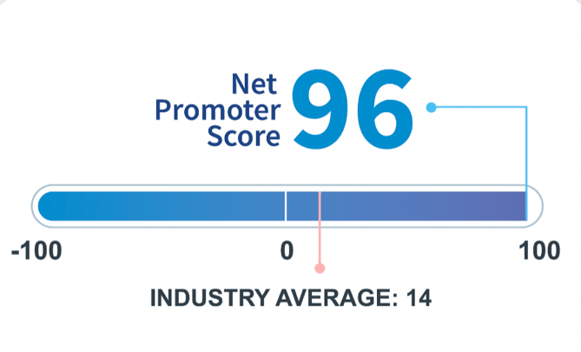
New Pharmacy Benefits Manager
If you enroll in a CareFirst plan, Capital Rx will manage
your prescription drug claims.
  Mail pharmacy services – through Optum RX
    Instructions will be mailed out to assist with the transition of your mail order prescription
  Speciality Pharmacy – Optum RX or JH Onsite Pharmacy
  Current prior authorizations – will be continued for 90 days
    Instructions will be mailed out early next year to assist with the transition
Capital Rx’s Net Promoter Score
Notes:
If you enroll in a CareFirst medical plan, you’ll also have access to Capital Rx.
Capital Rx will oversee this list of approved prescription drugs (which is referred to as the “formulary”). They’ll also process prescription drug claims.
We’re excited about partnering with Capital Rx because of their award-winning customer service. As you can see, Capital Rx has a net promoter score of 96 (how likely someone is to recommend them), which is well above the industry average.
Capital Rx will also:
Negotiate low drug costs and rebates with pharmaceutical manufacturers
Create and administer retail pharmacy networks
Develop and maintain formularies, which are lists of covered drugs
Provide mail pharmacy services
Ensure clinically appropriate drug use

Slide 8
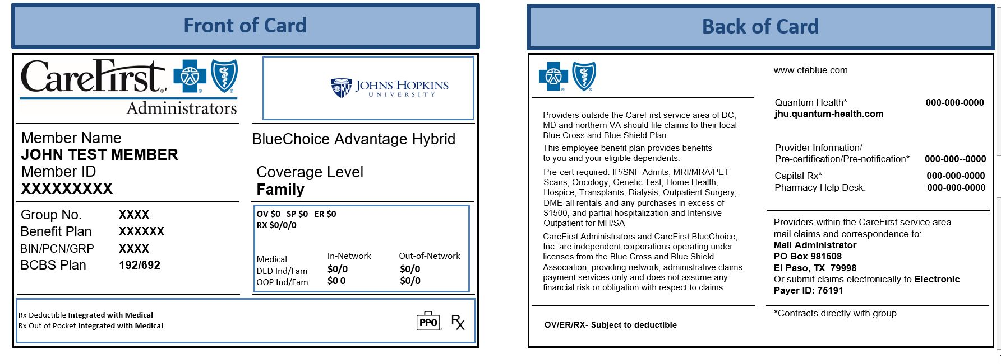
One Card for Medical and Prescription Drugs
Front of Card
Back of Card
Contact info for Quantum Health and Capital Rx will be on the back of your insurance card.
Notes:
If you enroll in one of the CareFirst medical plans, you’ll receive one medical ID card with information about both your medical and pharmacy benefits. This includes contact info for Quantum Health and Capital Rx.
If you have a question about any of your medical benefits, you’ll want to start with Quantum Health.

Slide 9

Additional Changes
For CareFirst medical plans:
Combined out-of-pocket maximum for medical, mental health, and prescription drugs
Referrals not required, but prior authorization needed for certain surgeries and services (Quantum Health will help coordinate)
For all medical plans:
Due to the end of the public health emergency, COVID-19 tests, including over-the-counter COVID-19 tests, are no longer covered at 100% by JHU’s medical plans.
For medical and dental:
Modest increases to premiums for 2024
Notes:
Additional changes to note if you select one of the CareFirst medical plans:
New this year, you’ll have a combined out-of-pocket maximum (the most you’ll pay in a year for medical, mental health, and prescription drugs).
Also new this year, you’ll need prior authorization for certain surgeries and services (these include diagnostic tests and scans, oncology care and services, dialysis, transplants, hospice care, hospitalization, inpatient care—including inpatient and skilled nursing facility admissions—and medical equipment rentals or purchases).
[Read language about COVID-19 test kits]
Additionally, there will be modest increases to medical and dental premiums—i.e., your monthly paycheck contributions—for 2024. As with previous years, JHU will absorb a large share of the cost increases to keep costs down for you.

Slide 10

Potential Limit Increases for Tax-Advantaged Accounts
Flexible Spending Account (FSA) limits may increase
  Health Care FSA – current limit is $3,050
  Dependent Care FSA – $5,000 per household
New! Commuter Assistance Program
Save money on expenses associated with traveling to work, including transit, parking, or both.
Deductions are made pretax (and reduce your taxable income).
The pretax spending limit for non-JHU parking is $300 per month (and is subject to change).
Additionally, JHU provides a subsidy for mass transit of up to $60 per month to eligible employees.
If you contribute pretax money, the maximum for your and JHU’s combined contributions is $300 per month (and is subject to change).
Notes:
[Add FSA and Dependent Care FSA limits when available]
JHU’s new commuter assistance program allows you to have pretax deductions taken from your pay to cover eligible expenses associated with your commute to work, such as public transportation and non-JHU parking. You may elect a transit account, parking account, or both.
You can make a one-time election to cover the same expenses each month, but if your commuting needs change, you can make changes to your elections every month. New elections take effect the month after they are submitted and are managed by WEX, our commuter assistance program administrator.
In 2024, the pretax spending limit for non-JHU parking will be $300 per month, and the limit for mass transit will be $300 per month.
JHU may contribute a subsidy for mass transit of up to $60 per month for eligible employees, to help lessen the cost of commuting. Subsidy amounts are determined by your gross annual salary and the number of days you work on campus.
If you’re eligible, you will have the option to select the JHU subsidy and/or elect your own pretax contribution. You do not need to make employee contributions to your commuter assistance account to receive the JHU-paid subsidy. The annual maximum (in 2024) for your and JHU’s combined contributions is $300 per month.
Employer funds will be added to your account in the first pay of each month. Unused funds will roll over month to month and year to year.
If you already have a WEX debit card for your Health Care FSA, simply use that card for your transit or parking expenses. Otherwise, check your mail for your new WEX debit card. You can also request reimbursement from WEX (online or app) if you pay out of pocket for any of your transit costs.

Slide 11



More About Your JHU Benefits
Medical
Dental
Vision
Tax-advantaged accounts
Life insurance
Disability protection
Voluntary benefits
Benefits you select any time

Slide 12
Medical Plan Options
All our medical plans cover in-network preventive care at 100%:
Annual checkups
Immunizations
Screenings to help you stay healthy and detect or prevent
serious illness
  Routine GYN exams, including Pap smear—one per calendar year
  Mammography screenings (in accordance with guidelines from American Cancer Society)
  Colonoscopies (in accordance with ACA guidelines)
  Skin cancer prevention screenings
  Routine vision exams
Pre- and post-natal care
And more!

Slide 13

Telehealth Can Save You Time and Money!
All our medical plans offer convenient access to telehealth services, so you can meet with a provider by video on your smartphone, tablet, or computer.
Each plan has a telehealth app.
Telehealth visits generally cost less but are still subject to the deductible.
Convenient for nonemergency needs, such as sinus infection, sore throat, etc.
You can also use telehealth for mental health, diet or nutrition, or breastfeeding support.

Slide 14
Medical Plan Options
 | CareFirst Core PPO Plan | LiUNA BU CareFirst Network Only Plan | Kaiser Permanente HMO Plan
Provider network | BlueChoice Advantage PPO network (through CareFirst) | BlueChoice Advantage network (through CareFirst) | Kaiser Permanente
Annual deductible | In-network: $500 individual $1,500 family Out-of-network: $1,000 individual $3,000 family | In-network: None Out-of-network: Not covered | In-network: None Out-of-network: Not covered
Out-of-pocket maximum | In-network: $2,000 individual $6,000 family Out-of-network: $4,000 individual $8,000 family | In-network: $1,500 individual $4,500 family Out-of-network: Not covered | In-network: $3,500 individual $9,400 family Out-of-network: Not covered
Coinsurance | In-network: 20% Out-of-network: 30% | In-network: None Out-of-network: Not covered | In-network: None Out-of-network: Not covered
Notes:
The chart on this slide illustrates key features of the medical plans and how they compare [Walk through table]
---
Our three medical plan options cover emergency care and prescriptions, and limit the amount you will pay out of pocket each year.
The plans differ in which providers (doctors, hospitals, etc.) you can see, and how the plans pay for medical expenses.
The CareFirst Core Plan allows you to use in-network and out-of-network providers, although you’ll pay less when you stay in-network.
The LiUNA BU CareFirst Network Only Plan offers a network of providers located throughout the community but does not cover out-of-network care (unless it is a true emergency).
There are no changes to the Kaiser HMO plan.
---
The annual deductible is what you pay for medical and mental health services before the plan pays benefits.
The out-of-pocket maximum is the most you’ll pay in a year for medical, mental health, and prescription drugs.
Coinsurance is what you pay for most services after the deductible is met.

Slide 15
Medical Plan Options
 | CareFirst Core PPO Plan | LiUNA BU CareFirst Network Only Plan | Kaiser Permanente HMO Plan
Quantum Health access | Yes | Yes | No
Health Care FSA eligible | Yes | Yes | Yes
Prescription drugs managed by | Capital Rx | Capital Rx | Kaiser Permanente
Prescription drugs: retail (up to 30-day supply) | Generic: $10 copay Formulary brand name: You pay 20% of the cost ($30 min / $45 max) Non-formulary brand: You pay 25% of the cost ($60 min / $100 max) |  | Generic: $7 / $10 copay Formulary brand name: $15 / $20 copay Non-formulary brand: $30 / $35 copay Copay prices shown are Kaiser / community pharmacies
Prescription drugs: retail (up to 90-day supply) | Generic: $25 copay Formulary brand name: $75 copay Non-formulary brand: $150 copay |  | Generic: $14 copay Formulary brand name: $30 copay Non-formulary brand: $60 copay
Notes:
Here are additional key features of the medical plans and how they compare [Walk through table]
Both the CareFirst Core Plan and the LiUNA BU CareFirst Network Only Plan will now require prior authorization for some surgeries and services, which Quantum Health will coordinate.

Slide 16
Dental Plan Options
 | Delta Dental Core (no orthodontia) | Delta Dental Enhanced (with orthodontia)
Annual deductible | Single: $75 Family: $150 | Single: $50 Family: $100
Preventive care (plan pays) | 100% in-network, no deductible | 100% in-network, no deductible
Basic services | You pay 30% of cost after deductible is met | You pay 10% of cost after deductible is met
Major services, implants | You pay 50% of cost after deductible is met | You pay 40% of cost after deductible is met
Orthodontia | Not covered | You pay 50% of cost after deductible is met
Annual benefit maximum (excludes orthodontia) | $1,000 | $2,000
Lifetime maximum benefit for orthodontia (per covered member) | Not covered | $2,000
Notes:
We offer two dental options: The Delta Dental Core plan and the Delta Dental Enhanced plan.
Both dental plan options feature the Delta Dental PPO network of providers. Both options will pay benefits for out-of-network providers, but you’ll pay more if you go out-of-network.
As you can see, the Core plan does not cover orthodontia; while the Enhanced plan does cover orthodontia and pays a higher level of benefits.
Both plans offer access to two networks of dental providers:
Delta Dental PPO: These dentists have agreed to reduced fees, so you won’t get charged more than your expected share of the bill.
Delta Dental Premier: If you can’t find a PPO dentist, Delta Dental Premier dentists offer the next best opportunity to save, because these dentists have agreed to set fees.

Slide 17
EyeMed Vision Plan
Plan Features | EyeMed Vision Plan
Eye exam | You pay $10 copay (once yearly)
Lenses (single vision, lined bifocal, lined trifocal, lenticular) | You pay $20 copay (once yearly)
Frames | $150 allowance (once yearly)
Contact lenses (in lieu of frames and lenses) Elective contact lenses Medically necessary contact lenses | $150 allowance 100% (plan pays)
Laser vision correction | 15% discount
Notes:
The EyeMed vision plan also remains unchanged.
The following are some highlights of your vision plan: [Walk through table]

Slide 18

Flexible Spending Accounts (FSAs)
Health Care Flexible Spending Account (FSA) lets you set aside
$3,050 in pretax dollars from your paycheck that you can
then use to pay for expenses like medical deductibles, prescription drugs, and eyeglasses.
Dependent Care Flexible Spending Account (DC FSA)
allows you to use $5,000—$2,500 if you are married and
file taxes separately—in pretax dollars to pay for
things like after-school care, summer day camp,
and elder care.
Notes:
You can save money on your health care and dependent care expenses by enrolling in the Health Care and/or Dependent Care Flexible Spending Accounts (FSAs).
You decide how much to set aside from your paycheck on a pretax basis to pay for eligible health care and child or other dependent care expenses.

Slide 19

Child Care Voucher and Scholarships
Annual Enrollment is the time to apply or reapply for the Child Care Voucher program for 2024.
New AGI limits for 2024 and increased scholarship award amounts
Vouchers provide tax-free financial assistance to pay for child care.
You can also apply for a child care scholarship to be used at one of JHU’s partner centers.
1 Pre-K Child Under Age 6 | 2 Pre-K Children Under Age 6 | 3 Pre-K Children Under Age 6 | Voucher Award
Family Adjusted Gross Income (AGI) |  |  | Per Family
≤$60,000 | ≤$70,000 | ≤$80,000 | $5,000
$60,001 - $90,000 | $70,001 - $100,000 | $80,001 - $110,000 | $2,500
$90,001 - $120,000 | $100,001 - $130,000 | $110,001 - $140,000 | $1,000
For children ages
0–5, not in kindergarten
For any type of
paid care (not just licensed) during scheduled work hours
For each additional child under 6, the income caps rise $10,000.
A copy of your most recent tax filing is required at enrollment.
Notes:
As a reminder, now is the time to apply and reapply for the Child Care Voucher program for 2024.
Through this program, you will have the opportunity to apply for tax-free assistance to help pay for child care for your prekindergarten children under age 6.
If you meet the eligibility criteria, you could be awarded up to $5,000 in voucher funds to use toward the cost of your child care. You can also apply for a child care scholarship to be used at one of JHU’s partner centers.
Remember, you must apply for the Child Care Voucher program during Annual Enrollment. Applications will only be accepted outside the enrollment period for new hires and employees who have a qualifying life event, such as a birth, adoption, or marriage, or if a spot at a partner center becomes available for a scholarship recipient.
Learn more about the eligibility criteria on Benefits & Worklife.

Slide 20

Life Insurance
JHU pays the full cost of basic and dependent life insurance:
Basic: 100% of base salary
Supplemental: Additional 100% of base salary
Dependent: $4,000 for spouse or domestic partner and $2,000 per child
If you elect supplemental life insurance, you pay
the difference and must provide evidence
of insurability (EOI).
Notes:
JHU pays the full cost of basic and dependent life insurance.
If you elect supplemental life insurance, you pay the difference and must provide evidence of insurability (EOI).

Slide 21
Disability Protection
Short-term disability: After a 14-day period, replaces 60% of your pay for up to 11 weeks (up to $2,500 weekly)
Automatically provided
Long-term disability: After 90 consecutive days, replaces 60% of your pay (up to $10,000 monthly)
Notes:
JHU offers you the ability to purchase short-term disability coverage, which provides a portion of your income for a short-term absence from work due to an illness or injury.
JHU also provides, free of charge, long-term disability insurance to all full-time, benefits-eligible faculty, staff, and LiUNA bargaining unit members who have completed one year of service.
This insurance pays a portion of your income when disability makes work impossible over a long period of time.

Slide 22

Voluntary Benefits
Identity theft protection
Pet insurance
Auto insurance
Homeowner’s insurance
Critical illness insurance
Accident insurance
Legal plan
Notes:
JHU’s voluntary benefits can provide extra protection and peace of mind for you and your family. These include: [Walk through slide]

Slide 23
Other Benefits That Support Your Well-Being
The 403(b) retirement plan (TIAA)
The Bargaining Unit Employees’ Retirement Pension Plan (Empower)
MMA’s Prosper Wise
Family and caregiving programs
Healthy at Hopkins
The Johns Hopkins Employee Assistance
Program (JHEAP)
Tuition grants and assistance
Coming Soon GED assistance!!!
Notes:
JHU also provides a variety of benefits to support your overall well-being, including:
Bargaining Unit Employees’ Retirement Pension Plan (Empower) pays you a monthly income once you retire, based on your length of service with the university, your earnings and salary history while at JHU, and your age when you retire and begin receiving payments
MMA’s Prosper Wise for financial coaching and tools to manage your financial well-being
Family and caregiving programs for help finding care plus backup child and elder care services; vouchers to help pay child care for children ages 0–5, and several child care partners with which Hopkins affiliates have preferred admission
Healthy at Hopkins for programs to help with physical fitness, weight loss, stress management, cancer support, and care management
The Johns Hopkins Employee Assistance Program (JHEAP) for around-the-clock support and assistance to help you manage your daily life; access to up to six free confidential counseling sessions and referral services per year for you and members of your household
Tuition grants and assistance to help put the power of higher education in reach for you, your spouse or partner, or your dependent children

Slide 24





Actions Needed
Elections That May Require Action
Elections That Will Carry Over

Slide 25


Elections That May Require Action
You must enroll if you’d like to:
  Select a medical plan.
    If you don’t choose your medical plan, we’ll enroll you in one
    (more details to come in the next slide).
  Participate in tax-advantaged spending and
  savings accounts.
    Health Care Flexible Spending Account (FSA)
    Dependent Care FSA
  Apply (or reapply) for the Child Care Voucher program
  and/or scholarship to JHU Partner Centers.
  Add or remove dependents.
Notes:
Reenroll in a spending account. If you don’t reselect your Health Care Flexible Spending Account (FSA) or Dependent Care FSA, it will reset to $0.

Slide 26
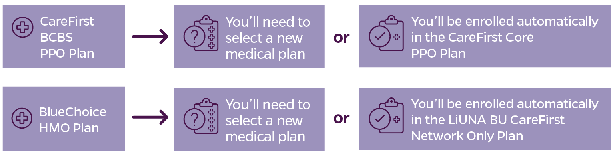

Choosing Your Medical Plan
This year, you must enroll if you’d like to select your medical plan.
If you don’t select a new medical plan, we’ll enroll you in the plan and coverage level (individual or family) that’s the closest to what you have now (at 2024 costs):
Notes:
Because we’re making changes to our medical plan options, you may want to select a new plan during Benefits Enrollment to make sure you have the coverage you want in 2024.
If you’re currently enrolled in either the CareFirst BCBS PPO Plan or the BlueChoice HMO Plan and you don’t select a new plan, you’ll be enrolled automatically in the CareFirst Core PPO Plan or the LiUNA BU CareFirst Network Only Plan at the same coverage level you have now (with 2024 costs).
If you’re currently enrolled in the Kaiser Permanente HMO Plan and you don’t select a new plan, you’ll stay enrolled at the same coverage level you have now (with 2024 costs).

Slide 27
Elections That Will Carry Over
Dental
Vision
Life insurance
Disability protection
Voluntary benefits
Notes:
Voluntary benefits include ID theft protection, legal plan, and insurances for pet, auto, home, critical illnesses, and accidents.

Slide 28

Hopkins Community Programs
United Way
As you enroll, you can support our partnership with
the United Way.
The 2023 United Way Campaign takes place from
October 25 to December 22, 2023.
Vernon Rice Memorial Holiday Turkey Program
Another quick and easy way to give to the community is through our holiday turkey program.
A $25 donation will provide a basket of a fresh turkey and vegetables
from a local farm to a family in need. The baskets are delivered by
St. Anthony of Padua Church for the Thanksgiving and December holidays.

Slide 29





Where to Learn More and Get Help

Slide 30
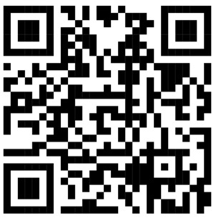
Learn More and Get Help Making Decisions
Attend an on-site benefits fair between 10 a.m. and 2 p.m.:
October 10 at East Baltimore (Turner Concourse)
October 11 at Homewood (Glass Pavilion)
Go to hr.jhu.edu/benefits-worklife to:
Compare medical plan options
Find answers to FAQs
Enroll by October 31!
Questions? Contact the Benefits Service Center:
benefits@jhu.edu or 410-516-2000
Notes:
You can continue to find all your enrollment information in one place.
Go to hr.jhu.edu/benefits-worklife/ to find all your benefits and enrollment information.
Once you have learned about your options, planned your choices, and are ready to take action, click the Enroll Now button.
Bargaining Unit employees will receive Annual Enrollment material mailed to their homes.

Slide 31
Thank you!

