Slide 1






2024 Benefits Enrollment Overview
For Faculty and Staff
Notes:
Welcome to the 2023 annual enrollment presentation for full-time faculty and staff.
The purpose of today’s meeting is to provide you with an overview of the benefits JHU will offer in 2024, and the tools and resources that you can use to help you choose your benefits.

Slide 2

Today We’ll Discuss
Benefits enrollment overview
What’s new for 2024?
More about your JHU benefits
Actions needed
Where to learn more and get help
Questions?
Benefits Enrollment is October 11–31, 2023

Slide 3






Benefits Enrollment Is October 11–31, 2023
Medical
Dental
Vision
Tax-advantaged accounts
Life insurance
and disability coverage
And
more!
Notes:
Benefits enrollment is your once-a-year opportunity to elect certain benefits (except for when you experience a life event, like getting married, adding a child to your family, or when a spouse or partner loses their job).
During this time, you can enroll in certain benefits including:
Medical, dental, or vision coverage
Spending accounts (FSA, DCFSA, HSA)
Commuter assistance
Child care vouchers and scholarships
Life insurance
Disability coverage
Accidental death and dismemberment (AD&D) insurance
Voluntary benefits (ID theft protection, legal plan, and pet, home and auto, critical illness, and accident insurance)
Additionally, we offer a range of health and financial benefits that you can enroll in at any time, which we’ll also highlight today.

Slide 4





What’s New for 2024?
New medical plan options
New health care advocacy service
New pharmacy benefits manager
Increased limits for tax-advantaged accounts
Enhanced commuter benefits
Notes:
After receiving feedback from you about JHU’s health insurance plan providers and services, we organized a working group of faculty and staff members in 2022 and conducted a comprehensive review of JHU’s medical plans, providers, and services.
One of the main takeaways from their review was that our health plan participants would benefit from a more patient-centered, streamlined, and cost-effective health care experience.
We’re excited to introduce enhancements to our benefits in 2024 to address frustrations you may have experienced and to address our working group’s recommendations. These include:
New medical plan options
New health care advocacy service
New pharmacy benefits manager
Additionally, we’ll cover changes to tax-advantaged spending accounts.
We’ll go through each of these changes in detail now.

Slide 5
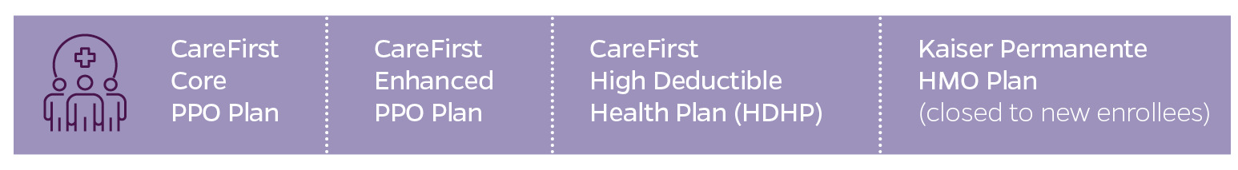
New Medical Plan Options
Beginning in 2024, we’ll offer:
A single health insurance administrator, CareFirst BlueCross BlueShield, through which you’ll have three medical plans to choose from
An HMO through Kaiser Permanente (only available if you currently
have Kaiser)
The EHP Classic POS Plan will no longer be available.
Notes:
We’ve decided that the best way to keep supporting our plan participants’ diverse needs—including your and your family’s health and overall well-being—is to move to a single health insurance vendor through Blue Cross Blue Shield.
In 2024, we’ll offer:
A single network of physicians and providers through CareFirst BlueCross BlueShield (BCBS)
An HMO through Kaiser Permanente (only available if you currently have Kaiser)
The EHP Classic POS Plan will no longer be available.

Slide 6

New Health Care Advocacy Service:
Quantum Health
As CareFirst members, you will have access to your own personal, expert health care guide, who can help you:
Get answers to your claims and billing questions
Find in-network providers
Verify coverage and, if needed, get prior approval
Access clinical support from trained nurses
Set up appointments and make preadmission or post-discharge plans for hospital stays
Save on out-of-pocket costs
Get the most out of your JHU medical benefits
Notes:
If you enroll in a CareFirst medical plan, you’ll have access to an enhanced service provided by Quantum Health.
Quantum Health is the industry-leading health care navigation and care coordination company. They will be your go-to contact for all questions, both big and small, about your medical benefits.
Quantum Health will work with health care providers and CareFirst to make sure that you get the best care for the best cost and that your medical claims are paid correctly. They can also help you understand and connect with all the medical benefits available to you. When you don’t know where to begin, Quantum Health’s Care Coordinators can help.
Care Coordinators are your personal team of nurses and medical benefits experts who work with you and your providers to make your care simpler and more affordable. They can help you find providers who understand your unique needs and background, and they can advocate on your behalf to ensure that you receive the best possible care. When you need help solving a claims issue, learning about your medical benefits, or dealing with anything else that can make your health care easier, you can contact Quantum Health online or over the phone.
For example, they can help you [read list in slide]

Slide 7

Quantum Health Advocacy Service
Notes:
Here’s a little more about Quantum Health, in their own words.
[Embed video: https://quantumhealth.wistia.com/medias/xr8kgum64g]

Slide 8
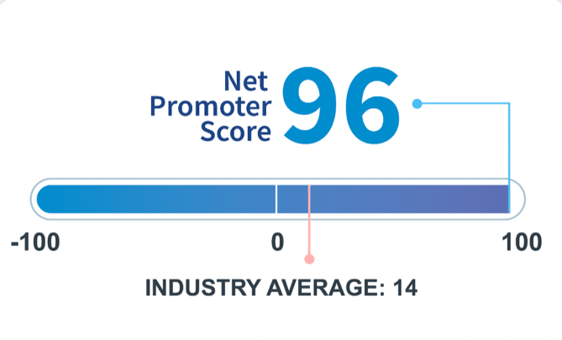
New Pharmacy Benefits Manager
If you enroll in a CareFirst plan, Capital Rx will manage
your prescription drug claims.
  Mail pharmacy services – through Optum RX
    Instructions will be mailed out to assist with the transition of your mail order prescription
  Speciality Pharmacy – Optum RX or JH Onsite Pharmacy
  Current prior authorizations – will be continued for 90 days
    Instructions will be mailed out early next year to assist with the transition
Capital Rx’s Net Promoter Score
Notes:
If you enroll in a CareFirst medical plan, you’ll also have access to Capital Rx.
Capital Rx will oversee this list of approved prescription drugs (which is referred to as the “formulary”). They’ll also process prescription drug claims.
We’re excited about partnering with Capital Rx because of their award-winning customer service. As you can see, Capital Rx has a net promoter score of 96 (how likely someone is to recommend them), which is well above the industry average.
Capital Rx will also:
Negotiate low drug costs and rebates with pharmaceutical manufacturers
Create and administer retail pharmacy networks
Develop and maintain formularies, which are lists of covered drugs
Provide mail pharmacy services
Ensure clinically appropriate drug use

Slide 9
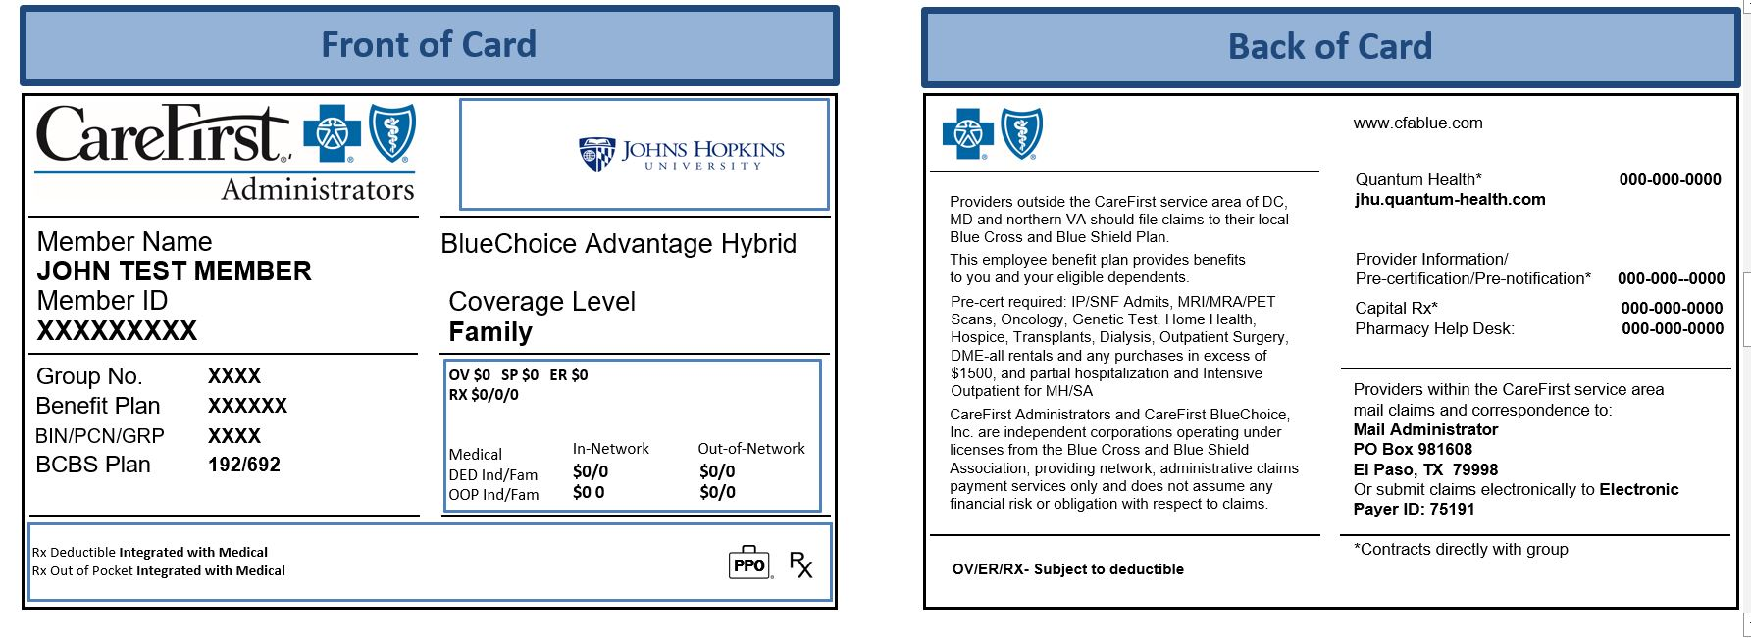
One Card for Medical and Prescription Drugs
Front of Card
Back of Card
Contact info for Quantum Health and Capital Rx will be on the back of your insurance card.
Notes:
If you enroll in one of the CareFirst medical plans, you’ll receive one medical ID card with information about both your medical and pharmacy benefits. This includes contact info for Quantum Health and Capital Rx.
If you have a question about any of your medical benefits, you’ll want to start with Quantum Health.

Slide 10

Additional Changes
For CareFirst medical plans:
Combined out-of-pocket maximum for medical, mental health, and prescription drugs
Referrals not required, but prior authorization needed for certain surgeries and services (Quantum Health will help coordinate)
For all medical plans:
Due to the end of the public health emergency, COVID-19 tests, including over-the-counter COVID-19 tests, are no longer covered at 100% by JHU’s medical plans.
For medical and dental:
Modest increases to premiums for 2024
Notes:
Additional changes to note if you select one of the CareFirst medical plans:
New this year, you’ll have a combined out-of-pocket maximum (the most you’ll pay in a year for medical, mental health, and prescription drugs).
Also new this year, you’ll need prior authorization for certain surgeries and services (these include diagnostic tests and scans, oncology care and services, dialysis, transplants, hospice care, hospitalization, inpatient care—including inpatient and skilled nursing facility admissions—and medical equipment rentals or purchases).
[Read language about COVID-19 test kits]
Additionally, there will be modest increases to medical and dental premiums—i.e., your monthly paycheck contributions—for 2024. As with previous years, JHU will absorb a large share of the cost increases to keep costs down for you.

Slide 11

Increased Limits for Tax-Advantaged Accounts
Health Savings Account (HSA) limit increases
The amount you can save tax-free will increase in 2024:
  $3,850 → $4,150 (for individual coverage)
  $7,750 → $8,300 (for family coverage)
Flexible Spending Account (FSA) limits may increase
  Health Care FSA
  Limited Purpose FSA
  Dependent Care FSA
  *usually announced later in the fall
Notes:
In 2024, you can save even more with a Health Savings Account (HSA).
[Add FSA and Dependent Care FSA limits when available]

Slide 12

Commuter Assistance Program
Save money on expenses associated with traveling
to work, including transit, parking, or both.
Deductions are made pretax (and reduce your taxable income).
The pretax spending limit for non-JHU parking is $300 per month (and is subject to change).
New! Mass transit subsidy
Additionally, JHU now provides a subsidy for mass transit to eligible employees.
  Subsidy amounts are determined by your work location, salary, and the number of days you work on campus.
  If you work in Maryland: up to $60 per month
  If you work in Washington, D.C.: up to $150 per month
If you contribute pretax money, the maximum for your and JHU’s combined contributions is $300 per month (and is subject to change).
Notes:
JHU’s commuter assistance program allows you to have pretax deductions taken from your pay to cover eligible expenses associated with your commute to work, such as public transportation and non-JHU parking. You may elect a transit account, parking account, or both.
You can make a one-time election to cover the same expenses each month, but if your commuting needs change, you can make changes to your elections every month. New elections take effect the month after they are submitted and are managed by WEX, our commuter assistance program administrator.
In 2024, the pretax spending limit for non-JHU parking will be $300 per month, and the limit for mass transit will be $300 per month.
JHU may contribute a subsidy for mass transit to eligible employees who work in Maryland and Washington, D.C., to help lessen the cost of commuting. Subsidy amounts are determined by an eligible employee’s work location (Maryland or D.C.), their annual JHU gross salary, and the number of days they work on campus or on-site.
If you’re eligible, you will have the option to select the JHU subsidy and/or elect your own pretax contribution. You do not need to make employee contributions to your commuter assistance account to receive the JHU-paid subsidy. The annual maximum (in 2024) for your and JHU’s combined contributions is $300 per month.
Employer funds will be added to your account in the first pay of each month. Unused funds will roll over month to month and year to year.
If you already have a WEX debit card for your Health Care FSA, simply use that card for your transit or parking expenses. Otherwise, check your mail for your new WEX debit card. You can also request reimbursement from WEX (online or app) if you pay out of pocket for any of your transit costs.

Slide 13



More About Your JHU Benefits
Medical
Dental
Vision
Tax-advantaged accounts
Life insurance
Disability protection
Accidental death and dismemberment (AD&D) insurance
Voluntary benefits
Benefits you select any time

Slide 14
Medical Plan Options
All our medical plans cover in-network preventive care at 100%:
Annual checkups
Immunizations
Screenings to help you stay healthy and detect or prevent
serious illness
  Routine GYN exams, including Pap smear—one per calendar year
  Mammography screenings (in accordance with guidelines from American Cancer Society)
  Colonoscopies (in accordance with ACA guidelines)
  Skin cancer prevention screenings
  Routine vision exams
Pre- and post-natal care
And more!

Slide 15

Telehealth Can Save You Time and Money!
All our medical plans offer convenient access to telehealth services, so you can meet with a provider by video on your smartphone, tablet, or computer.
Each plan has a telehealth app
Telehealth visits generally cost less but are still subject to the deductible.
Convenient for nonemergency needs, such as sinus infection, sore throat, etc.
You can also use telehealth for mental health, diet or nutrition, or breastfeeding support.

Slide 16
Medical Plan Options
 | CareFirst High Deductible Health Plan (HDHP) | CareFirst Core PPO Plan | CareFirst Enhanced PPO Plan
Provider network | BlueChoice Advantage PPO network (through CareFirst)
Annual deductible | In-network: $1,750 individual $3,500 family Out-of-network: $3,500 individual $7,000 family | In-network: $500 individual $1,500 family Out-of-network: $1,000 individual $3,000 family | In-network: $250 individual $750 family Out-of-network: $500 individual $1,500 family
Out-of-pocket maximum | In-network: $3,500 individual $7,000 family Out-of-network: $7,000 individual $14,000 family | In-network: $2,000 individual $6,000 family Out-of-network: $4,000 individual $8,000 family | In-network: $1,000 individual $3,000 family Out-of-network: $2,000 individual $6,000 family
Coinsurance | In-network: 20% Out-of-network: 40% | In-network: 20% Out-of-network: 30% | In-network: 10% Out-of-network: 30%
Notes:
As you can see from the comparison chart, the new CareFirst medical plans now offer more choice in terms of what the plans will pay versus what you’ll pay.
The CareFirst Core Plan offers 80% coinsurance while the CareFirst Enhanced Plan offers 90% coinsurance.
The CareFirst High Deductible Health Plan (HDHP) offers a higher annual deductible and out-of-pocket maximum, but it also offers lower monthly per-paycheck premiums and access to a Health Savings Account (HSA), to which JHU contributes for eligible employees.
---
The annual deductible is what you pay for medical and mental health services before the plan pays benefits.
The out-of-pocket maximum is the most you’ll pay in a year for medical, mental health, and prescription drugs.
Coinsurance is what you pay for most services after the deductible is met.

Slide 17
Medical Plan Options
 | CareFirst High Deductible Health Plan (HDHP) | CareFirst Core PPO Plan | CareFirst Enhanced PPO Plan
Quantum Health access | Yes
HSA eligible | Yes | No
Health Care FSA eligible | No; Limited Purpose FSA only (for dental and vision care expenses only) | Yes | Yes
Prescription drugs managed by | Capital Rx
Prescription drug overview | After meeting the plan’s medical deductible, you pay a copay or coinsurance amount per prescription | No deductible; you pay copay or coinsurance depending on the type of drug | No deductible; you pay copay or coinsurance depending on the type of drug
Notes:
Here are additional key features of the medical plans and how they compare [Walk through table]
All three CareFirst plans include access to Quantum Health. Some surgeries and services may require prior authorization, which Quantum Health will coordinate.

Slide 18
Medical Plan Options
 | CareFirst High Deductible Health Plan (HDHP) | CareFirst Core PPO Plan | CareFirst Enhanced PPO Plan
Prescription drugs: retail (up to 30-day supply) | Generic: $10 copay after deductible Formulary brand name: You pay 20% of the cost after deductible is met Non-formulary brand: You pay 25% of the cost after deductible is met | Generic: $10 copay Formulary brand name: You pay 20% of the cost (max $60) Non-formulary brand: You pay 25% of the cost (max $125) | Generic: $10 copay Formulary brand name: You pay 10% of the cost (max $30) Non-formulary brand: You pay 10% of the cost (max $75)
Prescription drugs: mail order (up to 90-day supply) | Generic: $25 after deductible Formulary brand name: You pay 20% of the cost after deductible is met Non-formulary brand: You pay 25% of the cost after deductible is met | Generic: $20 copay Formulary brand name: You pay 20% of the cost (max $120) Non-formulary brand: You pay 25% of the cost (max $250) | Generic: $20 copay Formulary brand name: You pay 10% of the cost (max $60) Non-formulary brand: You pay 10% of the cost (max $150)
Notes:
Here are additional key features of the medical plans and how they compare [Walk through table]

Slide 19
Medical Plan Options
About the CareFirst High Deductible Health Plan (HDHP):
The High Deductible Health Plan (HDHP) works much like a traditional PPO plan, with
    Higher deductible and out-of-pocket maximum (applies to medical and prescription drug expenses)
    Lower employee premium
Teamed with a special tax advantaged Health Savings Account (HSA) which allows you to pay for certain medical, dental, and vision expenses with untaxed dollars
You have more control over how you fund and spend your
health care dollars.
Notes:
Let’s take a minute to review how the HDHP works.
With the HDHP, you can use both in- or out-of-network providers, but you generally pay more for out-of-network care.
The HDHP features a higher deductible and out-of-pocket maximum than a traditional PPO plan. The deductible and out-of-pocket maximum apply to both medical and prescription drug costs.
While the employee premium is lower, you have to pay more health care and prescription drug costs yourself before the plan starts to pay its share.
What makes this type of plan really unique is that it is teamed with a special Health Savings Account (HSA) that lets you save pretax funds to use for eligible health care expenses.

Slide 20
Medical Plan Options
How the HSA works:
A triple tax-advantaged Health Savings Account (HSA) exclusively for
HDHP participants
Use it to help fund out-of-pocket health care costs with
tax-free dollars.
You can contribute to your HSA on a before-tax basis.
If you earn $60,000 a year or less, JHU will make a contribution
to your HSA to help offset the higher deductible.
  $40,000 or less salary band: $500 Individual / $1,000 Family
  $40,001–$60,000 salary band: $250 Individual / $500 Family
Funds roll over from year to year, so you can use them now—
or save and invest them for later.
Notes:
If you choose the HDHP, you are eligible to participate in a tax-advantaged Health Savings Account (HSA) to help fund your out-of-pocket health care costs.
You can contribute to your HSA on a before-tax basis.
If you earn $60,000 or less a year, JHU will make a contribution to your HSA to help offset the higher deductible.
Unlike the FSA, the savings you accumulate roll over from year to year, so you can choose to use them for eligible expenses now, or save them for later. The money in your account is yours to keep. Like your 403(b) retirement account, you can take it with you if you leave JHU.

Slide 21



Health Savings Accounts (HSAs)
2
Stays tax-free
Use for deductible, coinsurance,
other eligible expenses
1
Money goes in tax-free
You choose
how to use
your account:
Spend it,
save it, or invest it
Your contributions
3
Grows tax-free
Rolls over year to year,
travels with you if
you leave or retire,
never forfeited
JHU’s contributions
Notes:
Here’s another look at HSAs and how they work:
You contribute money to your account with pretax payroll deductions. If you earn $60,000 or less a year, JHU will also make an annual contribution to your account.
You can spend it on eligible health care expenses, including your deductible, coinsurance, and out-of-pocket medical, dental, and vision expenses. Or you can save or invest it. If your medical expenses turn out to be low, the money in your account rolls over from year to year. You can even take your balance with you if you retire or leave JHU for any reason. HSA money is never forfeited.
The HSA offers a triple tax advantage: The money goes into your account tax-free, stays tax-free if you spend it on eligible expenses, and grows tax-free through interest and investment.
HSAs are a great way to save for health costs over the long term—not just year to year.
To have access to an HSA, you must enroll in the CareFirst High Deductible Health Plan (HDHP).

Slide 22
Dental Plan Options
 | Delta Dental Core (no orthodontia) | Delta Dental Enhanced (with orthodontia)
Annual deductible | Single: $75 Family: $150 | Single: $50 Family: $100
Preventive care (plan pays) | 100% in-network, no deductible | 100% in-network, no deductible
Basic services | You pay 30% of cost after deductible is met | You pay 10% of cost after deductible is met
Major services, implants | You pay 50% of cost after deductible is met | You pay 40% of cost after deductible is met
Orthodontia | Not covered | You pay 50% of cost after deductible is met
Annual benefit maximum (excludes orthodontia) | $1,000 | $2,000
Lifetime maximum benefit for orthodontia (per covered member) | Not covered | $2,000
Notes:
We offer two dental options: The Delta Dental Core plan and the Delta Dental Enhanced plan.
Both dental plan options feature the Delta Dental PPO network of providers. Both options will pay benefits for out-of-network providers, but you’ll pay more if you go out-of-network.
As you can see, the Core plan does not cover orthodontia; while the Enhanced plan does cover orthodontia and pays a higher level of benefits.
Both plans offer access to two networks of dental providers:
Delta Dental PPO: These dentists have agreed to reduced fees, so you won’t get charged more than your expected share of the bill.
Delta Dental Premier: If you can’t find a PPO dentist, Delta Dental Premier dentists offer the next best opportunity to save, because these dentists have agreed to set fees.

Slide 23
EyeMed Vision Plan
Plan Features | EyeMed Vision Plan
Eye exam | You pay $10 copay (once yearly)
Lenses (single vision, lined bifocal, lined trifocal, lenticular) | You pay $20 copay (once yearly)
Frames | $150 allowance (once yearly)
Contact lenses (in lieu of frames and lenses) Elective contact lenses Medically necessary contact lenses | $150 allowance 100% (plan pays)
Laser vision correction | 15% discount
Notes:
The EyeMed vision plan also remains unchanged.
The following are some highlights of your vision plan: [Walk through table]

Slide 24

Flexible Spending Accounts (FSAs)
A Health Care Flexible Spending Account (FSA) lets you set aside $3,050 in pretax dollars from your paycheck that you can then use to pay for expenses like medical deductibles, prescription drugs, and eyeglasses.
A Dependent Care Flexible Spending Account (DC FSA)
allows you to use $5,000—$2,500 if you are married and file taxes separately—in pretax dollars to pay for things like
after-school care, summer day camp, and elder care.
A Limited Purpose FSA allows you to set aside pretax
dollars for eligible dental and vision expenses ONLY if
you’re enrolled in an HDHP, because you can’t have
both an HSA and a Health Care FSA.
Notes:
You can save money on your health care and dependent care expenses by enrolling in the Health Care and/or Dependent Care Flexible Spending Accounts (FSAs).
You decide how much to set aside from your paycheck on a pretax basis to pay for eligible health care and child or other dependent care expenses.
Due to IRS rules, you cannot participate in the Health Care FSA if you elect an HDHP with an HSA. However, you can participate in a Limited Purpose FSA (LPFSA) offered exclusively for HDHP participants. The Limited Purpose FSA can be used for eligible dental and vision expenses only.

Slide 25
Comparing Health Care Spending Accounts
 | Health Care FSA | Health Savings Account (HSA) | Limited Purpose FSA
Medical plan it pairs with | CareFirst Core PPO CareFirst Enhanced PPO Kaiser HMO | CareFirst HDHP | CareFirst HDHP
Use it to pay | Eligible health care expenses (medical, dental, or vision) | Eligible health care expenses (medical, dental, or vision) | Eligible dental and vision expenses only
Who contributes | You | You (and JHU if you earn $60,000 or less) | You
Annual contribution limits | $3,050 | Up to $4,150 per individual and up to $8,300 per family (including the JHU contribution) | $3,050
Does the balance roll over? | You can roll over up to $610 of unused funds ($30 min.); remainder is forfeited | Yes | You can roll over up to $610 of unused funds ($30 min.); remainder is forfeited
Notes:
As you choose your medical plan, it’s important to understand the tax-advantaged spending account options available with each medical option and how they differ. [Walk through chart.]
The amount you can save in a Flexible Spending Account (FSA) or Limited Purpose FSA may increase for 2024. Once announced, those new limits will be shared.
Keep in mind that if you elect the HDHP and you are currently participating in the Health Care FSA, you will want to spend down any remaining balance.
As mentioned on a previous slide, you also have the option to contribute pretax money to a Dependent Care Flexible Spending Account to pay for eligible child and elder care expenses.

Slide 26

Child Care Voucher and Scholarships
Annual Enrollment is the time to apply or reapply for the Child Care Voucher program for 2024.
New AGI limits for 2024 and increased scholarship award amounts
Vouchers provide tax-free financial assistance to pay for child care.
You can also apply for a child care scholarship to be used at one of JHU’s partner centers.
1 Pre-K Child Under Age 6 | 2 Pre-K Children Under Age 6 | 3 Pre-K Children Under Age 6 | Voucher Award
Family Adjusted Gross Income (AGI) |  |  | Per Family
≤$60,000 | ≤$70,000 | ≤$80,000 | $5,000
$60,001 - $90,000 | $70,001 - $100,000 | $80,001 - $110,000 | $2,500
$90,001 - $120,000 | $100,001 - $130,000 | $110,001 - $140,000 | $1,000
For children ages
0–5, not in kindergarten
For any type of
paid care (not just licensed) during scheduled work hours
For each additional child under 6, the income caps rise $10,000.
A copy of your most recent tax filing is required at enrollment.
Notes:
As a reminder, now is the time to apply and reapply for the Child Care Voucher program for 2024.
Through this program, you will have the opportunity to apply for tax-free assistance to help pay for child care for your prekindergarten children under age 6.
If you meet the eligibility criteria, you could be awarded up to $5,000 in voucher funds to use toward the cost of your child care. You can also apply for a child care scholarship to be used at one of JHU’s partner centers.
Remember, you must apply for the Child Care Voucher program during Annual Enrollment. Applications will only be accepted outside the enrollment period for new hires and employees who have a qualifying life event, such as a birth, adoption, or marriage, or if a spot at a partner center becomes available for a scholarship recipient.
Learn more about the eligibility criteria on Benefits & Worklife.

Slide 27

Basic and Supplemental Life Insurance
JHU covers basic life insurance of $10,000 at no cost to you.
You can elect additional supplemental life insurance coverage of up to 8 times your annual base salary, to a
maximum benefit of $3,000,000 (basic and supplemental coverage combined).
If you elect supplemental life insurance for the first time
(and you’re not a new hire), you must provide evidence
of insurability (EOI).
If you’re currently enrolled in supplemental life insurance, you may elect to move up one coverage level without providing EOI (up to 4 times your base salary or $500,000).
Notes:
JHU covers basic life insurance of $10,000 at no cost to you. During Annual Enrollment, you can enroll in additional life coverage or increase your coverage, up to plan limits.
If you elect supplemental life insurance for the first time (and you’re not a new hire), you must provide evidence of insurability (EOI).
Also, if you’re currently enrolled in Supplemental Life Insurance, you may elect to move up one level of coverage during Annual Enrollment without completing evidence of insurability up to a maximum of 4 times your annual base salary, or $500,000.

Slide 28
Dependent Life Insurance
You can elect coverage for your spouse, domestic partner, and unmarried dependent child(ren) until the end of the year in which your dependent turns 26. Choose from two options:
Plan 1: $4,000 spouse or domestic partner;
$2,000 per dependent child
Plan 2: $10,000 for your spouse or domestic partner;
$5,000 per dependent child

Slide 29
Disability Protection
Short-term disability: After a 14-day period, replaces 60% of your pay for up to 11 weeks (up to $2,500 weekly). Pregnancy is covered under STD
Automatically provided
Long-term disability: After 90 consecutive days, replaces 60% of your pay (up to $10,000 monthly)
Notes:
JHU offers you the ability to purchase short-term disability coverage, which provides a portion of your income for a short-term absence from work due to an illness or injury.
JHU also provides, free of charge, long-term disability insurance to all full-time, benefits-eligible faculty, staff, and LiUNA bargaining unit members who have completed one year of service.
This insurance pays a portion of your income when disability makes work impossible over a long period of time.

Slide 30
Accidental Death and Dismemberment
(AD&D) Insurance
For you: Supplemental AD&D of up to 8 times your annual base salary, to a maximum benefit of $3,000,000
For your spouse or domestic partner and children: 50% of
your benefit amount, up to $250,000, for your spouse or domestic partner; 15% of your benefit amount, up to $50,000, for your children
For your spouse or domestic partner only: 60% of your
benefit amount, up to $250,000
For your children only: 20% of your benefit amount,
up to $50,000
Notes:
JHU automatically provides basic AD&D of $10,000 for you at no cost to you.
You can elect additional coverage for yourself and your family, which you pay for.
Your options are [walk through bullet points]

Slide 31

Voluntary Benefits
Identity theft protection
Pet insurance
Auto insurance
Homeowner’s insurance
Critical illness insurance
Accident insurance
Legal plan
Notes:
JHU’s voluntary benefits can provide extra protection and peace of mind for you and your family. These include: [Walk through slide]

Slide 32
Other Benefits That Support Your Well-Being
The 403(b) retirement plan (TIAA)
MMA’s Prosper Wise
Family and caregiving programs
Healthy at Hopkins
The Johns Hopkins Employee Assistance Program (JHEAP)
Tuition grants and assistance
Notes:
JHU also provides a variety of benefits to support your overall well-being, including:
The 403(b) retirement plan (TIAA) to set aside pretax or after-tax money for your future
MMA’s Prosper Wise for financial coaching and tools to manage your financial well-being
Family and caregiving programs for help finding care plus backup child and elder care services; vouchers to help pay child care for children ages 0–5, and several child care partners with which Hopkins affiliates have preferred admission
Healthy at Hopkins for programs to help with physical fitness, weight loss, stress management, cancer support, and care management
The Johns Hopkins Employee Assistance Program (JHEAP) for around-the-clock support and assistance to help you manage your daily life; access to up to six free confidential counseling sessions and referral services per year for you and members of your household
Tuition grants and assistance to help put the power of higher education in reach for you, your spouse or partner, or your dependent children

Slide 33




Actions Needed
Elections That May Require Action
Elections That Will Carry Over

Slide 34


Elections That Require Action
You must enroll if you’d like to:
  Select a medical plan.
    If you don’t choose your medical plan, we’ll enroll you in one (more details to come in the next slide).
  Participate in tax-advantaged spending and savings accounts.
    Health Savings Account (HSA)
    Health Care Flexible Spending Account (FSA)
    Limited Purpose FSA
    Dependent Care FSA
  Apply (or reapply) for the Child Care Voucher program
  and/or scholarship to JHU Partner Centers.
  Add or remove dependents.
  Increase your life insurance coverage.
Notes:
Reenroll in a spending account. If you don’t reselect your Health Savings Account (HSA), Flexible Spending Account (FSA), Limited Purpose FSA, or Dependent Care FSA, it will reset to $0.

Slide 35
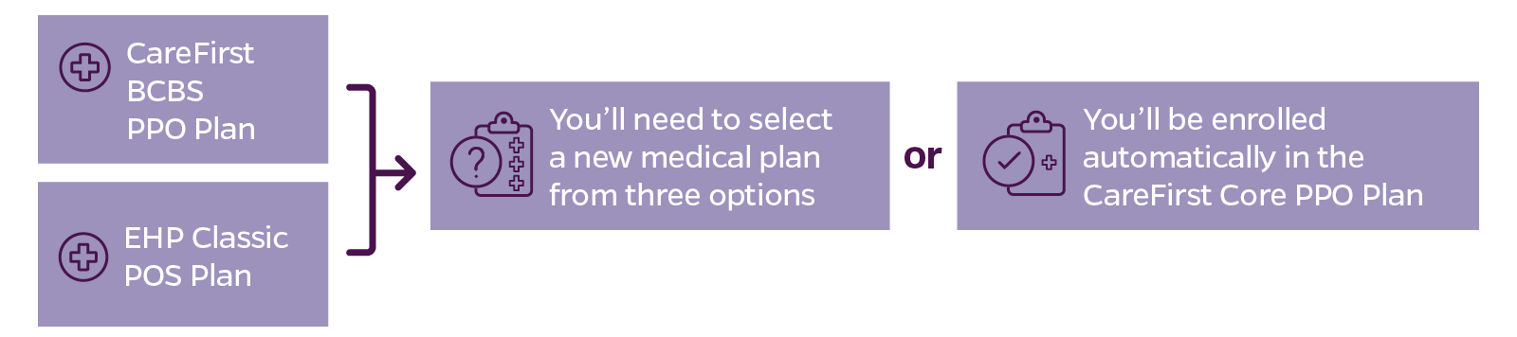
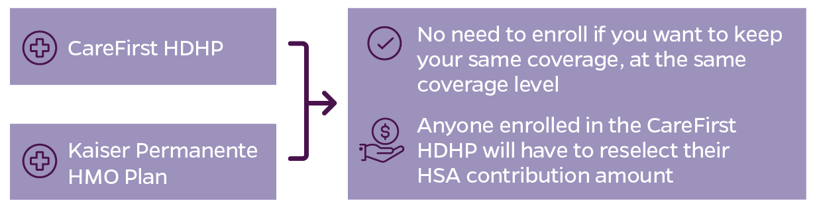
Choosing Your Medical Plan
This year, you must enroll if you’d like to select your medical plan.
If you don’t, we’ll enroll you in the plan and coverage level (individual or family) that’s the closest to what you have now (at 2024 costs):
Notes:
If you’re currently enrolled in either the CareFirst BCBS PPO Plan or the EHP Classic POS Plan and you don’t select a new plan, you’ll be enrolled automatically in the CareFirst Core PPO Plan at the same coverage level you have now (with 2024 costs). The CareFirst Core Plan offers 80% coinsurance (what the plan pays versus what you pay), which is the most similar to the current CareFirst BCBS PPO and EHP Classic POS Plans.
If you’re currently enrolled in either the CareFirst High Deductible Health Plan (HDHP) or the Kaiser Permanente HMO Plan and you don’t select a new plan, you’ll stay enrolled at the same coverage level you have now (with 2024 costs). Anyone enrolled in the CareFirst HDHP, however, will need to reselect their Health Savings Account (HSA) contribution amount.
Waiving medical coverage? You’re eligible for the annual waiver credit of $800 (if your annual salary is $40,000 or less) or $500 (if your annual salary is more than $40,000).

Slide 36
Elections That Will Carry Over
Dental
Vision
Life insurance
Disability protection
Accidental death and dismemberment (AD&D) insurance
Commuter benefits
Voluntary benefits
Notes:
Voluntary benefits include ID theft protection, legal plan, and insurances for pet, auto, home, critical illnesses, and accidents.

Slide 37

Hopkins Community Programs
United Way
As you enroll, you can support our partnership with
the United Way.
The 2023 United Way Campaign takes place from
October 25 to December 22, 2023.
Vernon Rice Memorial Holiday Turkey Program
Another quick and easy way to give to the community is through our holiday turkey program.
A $25 donation will provide a basket of a fresh turkey and vegetables
from a local farm to a family in need. The baskets are delivered by
St. Anthony of Padua Church for the Thanksgiving and December holidays.

Slide 38





Where to Learn More and Get Help

Slide 39

Interactive Decision Support
Wondering which benefits are right
for you? Try ALEX, our interactive decision-support tool.
ALEX acts as an informative, virtual benefits counselor to help you learn more about your JHU benefit options, so you can choose what’s best for you.
ALEX has been enhanced to improve its recommendations to better fit your risk tolerance and financial situation. You can even add a family member’s medical plan to compare options.
Go to hr.jhu.edu/benefits-worklife to
get started.
Notes:
Our decision-support tool, ALEX, has been updated to harness the power of AI to analyze your responses and make sure suggested plans fit your risk tolerance and financial situation, and has been proven to work for others like you. This year, enhancements to ALEX include:
New options to read text (instead of listen to audio)
New option to add in a family plan for comparison
New risk tolerance questions

Slide 40

Learn More and Get Help Making Decisions
Attend an on-site benefits fair between 10 a.m. and 2 p.m.:
October 10 at East Baltimore (Turner Concourse)
October 11 at Homewood (Glass Pavilion)
Go to hr.jhu.edu/benefits-worklife to:
Access ALEX—our virtual benefits counselor
Compare medical plan options
Find answers to FAQs
Enroll by October 31!
Questions? Contact the Benefits Service Center:
benefits@jhu.edu or 410-516-2000
Notes:
You can continue to find all your enrollment information in one place.
Go to hr.jhu.edu/benefits-worklife/ to find all your benefits and enrollment information.
Once you have learned about your options, planned your choices, and are ready to take action, click the Enroll Now button.

Slide 41
Thank you!

