Slide 1
2024 Retiree Benefits Overview
Notes:
Welcome to the 2024 benefits overview for retirees
The purpose of today’s meeting is to provide you with an overview of the benefits JHU will offer in 2024

Slide 2
2024 Changes
Starting April 2024, we’ll offer:
A single health insurance vendor through CareFirst BCBS
The EHP Classic POS Plan will no longer be available
Prescription drugs will now be managed by Capital Rx
Quantum Health will now service our medical and pharmacy plans
CareFirst PPO Plan
New CareFirst Core PPO Plan
EHP Classic Plan
BU CareFirst HMO plan
New CareFirst LiUNA BU Network Only Plan

Slide 3
Additional Changes
For CareFirst medical plans:
Combined out-of-pocket maximum for medical, mental health, and prescription drugs
Referrals not required, but prior authorization needed for certain surgeries and services (Quantum Health will help coordinate)
Due to the end of the public health emergency, COVID-19 tests, including over-the-counter COVID-19 tests, are no longer covered at 100% by JHU’s medical plans.
For medical and dental:
Modest increases to premiums for 2024
Notes:
Additional changes to note if you select the CareFirst medical plan:
New this year, you’ll have a combined out-of-pocket maximum (the most you’ll pay in a year for medical, mental health, and prescription drugs).
Also new this year, you’ll need prior authorization for certain surgeries and services (these include diagnostic tests and scans, oncology care and services, dialysis, transplants, hospice care, hospitalization, inpatient care—including inpatient and skilled nursing facility admissions—and medical equipment rentals or purchases).
[Read language about COVID-19 test kits]
Additionally, there will be modest increases to medical and dental premiums

Slide 4
Medical Plans
 | CareFirst Core PPO | CareFirst LiUNA BU Network Only Plan
Provider Network | CareFirst BlueChoice Advantage (PPO)
Annual Deductible | In-network: $500 individual $1,500 family Out-of-network: $1,000 individual $3,000 family | In-network: None Out-of-network: Not covered
Out-of-pocket maximum | In-network: $2,000 individual $6,000 family Out-of-network: $4,000 individual $8,000 family | In-network: $1,500 Individual $4,000 family Out-of-network: Not covered
Coinsurance | In-Network: 20% Out-of-Network: 30% | In- Network: None Out-of-Network: Not Covered
Primary Care Visit | Deductible & Coinsurance | $20 copay
Specialist Visit | Deductible & Coinsurance | $35 copay
Urgent Care | $50 copay | $25 copay
Emergency Room | $150 copay(waived if admitted) | $50 copay(waived if admitted)

Slide 5
Pharmacy Benefits – Capital Rx
 | CareFirst Core PPO Plan & LiUNA Network Only Plan
Prescription drugs: retail (up to 30-day supply) | Generic: $10 copay Formulary brand name: You pay 20% of the cost (min $30, max $45) Non-formulary brand: You pay 25% of the cost (min. $60, max $100)
Prescription drugs: mail order (up to 90-day supply) | Generic: $25 copay Formulary brand name: You pay 20% of the cost (min $75, max $112.50) Non-formulary brand: You pay 25% of the cost (min. $150, max $250)
Notes:
Here are additional key features of the medical plans and how they compare [Walk through table]

Slide 6
Free Biennial Eye Exams with Wilmer
As CareFirst Members:
You and your eligible dependents age 18 and older who are enrolled in the CareFirst Core PPO Plan or the LiUNA BU CareFirst Network Only Plan are eligible for a free eye exam every two years by a selected School of Medicine Wilmer Eye Institute provider in the Baltimore area. The comprehensive eye exam will consist of a routine eye exam and complete visual system exam.
Note: Eyeglasses and fitting or dispensing of new contact lenses are not included in the routine eye exam and are not covered.
Call 410-955-5080 to schedule an appointment.
Notes:
Here are additional key features of the medical plans and how they compare [Walk through table]

Slide 7
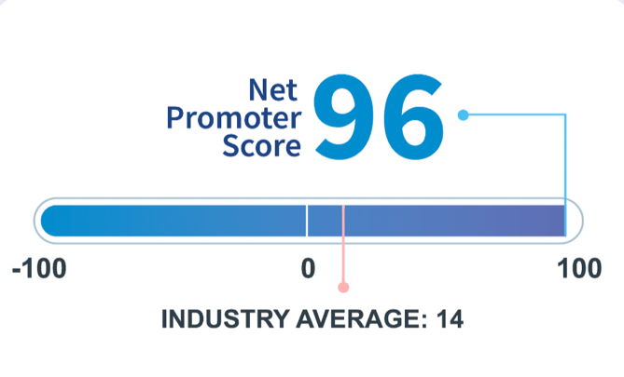
New Pharmacy Benefits Manager
If you enroll in a CareFirst plan, Capital Rx will manage your prescription drug claims.
Mail pharmacy services – through Optum Home Delivery
Instructions will be mailed out to assist with the transition of your mail order prescription
Prescriptions will not be transferred over until early April
Speciality Pharmacy – Optum RX or JH Onsite Pharmacy
Current prior authorizations – will be continued for 90 days
Instructions will be mailed out to assist with the transition
Capital Rx’s Net Promoter Score
Notes:
Capital Rx will now serve as your pharmacy provider.
Capital Rx will oversee this list of approved prescription drugs (which is referred to as the “formulary”). They’ll also process prescription drug claims.
We’re excited about partnering with Capital Rx because of their award-winning customer service. As you can see, Capital Rx has a net promoter score of 96 (how likely someone is to recommend them), which is well above the industry average.
Capital Rx will also partner with Optum Home delivery for mail order needs. If you are currently utilizing mail order and an active prescription with remaining refills, your prescription will roll over to Optum Home Delivery. This will happen in mid-April and you will receive a letter in the mail with next steps. You will have to log in to set up your account and shipping information.
Speciality medications will be managed through Optum or Johns Hopkins Onsite Pharmacy. Your current prior authorization will carry over for 90 days and then you will receive instructions in the mail on next steps.

Slide 8
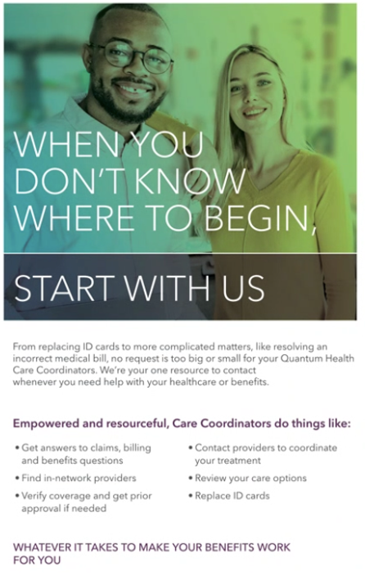
New Health Care Advocacy Service: Quantum Health
As CareFirst members, you will have access to your own personal, expert health care guide, who can help you:
Get answers to your claims and billing questions
Find in-network providers
Verify coverage and, if needed, get prior approval
Access clinical support from trained nurses
Set up appointments and make preadmission or post-discharge plans for hospital stays
Save on out-of-pocket costs
Get the most out of your JHU medical benefits
Notes:
You’ll have access to an enhanced service provided by Quantum Health.
Quantum Health is the industry-leading health care navigation and care coordination company. They will be your go-to contact for all questions, both big and small, about your medical benefits.
Quantum Health will work with health care providers and CareFirst to make sure that you get the best care for the best cost and that your medical claims are paid correctly. They can also help you understand and connect with all the medical benefits available to you. When you don’t know where to begin, Quantum Health’s Care Coordinators can help.
Care Coordinators are your personal team of nurses and medical benefits experts who work with you and your providers to make your care simpler and more affordable. They can help you find providers who understand your unique needs and background, and they can advocate on your behalf to ensure that you receive the best possible care. When you need help solving a claims issue, learning about your medical benefits, or dealing with anything else that can make your health care easier, you can contact Quantum Health online or over the phone.
For example, they can help you [read list in slide]

Slide 9
Quantum Health Advocacy Service
Notes:
Here’s a little more about Quantum Health, in their own words.
[Embed video: https://quantumhealth.wistia.com/medias/xr8kgum64g]

Slide 10
One Card for Medical and Prescription Drugs
Front of Card
Back of Card
Contact info for Quantum Health and Capital Rx will be on the back of your insurance card.
Notes:
If you enroll in one of the CareFirst medical plans, you’ll receive one medical ID card with information about both your medical and pharmacy benefits. This includes contact info for Quantum Health and Capital Rx.
If you have a question about any of your medical benefits, you’ll want to start with Quantum Health.

Slide 11
Telehealth Can Save You Time and Money!
The CareFirst medical plans offer convenient access to telehealth services, so you can meet with a provider by video on your smartphone, tablet, or computer.
Telehealth visits will be a standard copay of $20 for the Core plan and $15 for the LiUNA In-Network Only plan.
Convenient for nonemergency needs, such as sinus infection, sore throat, etc.

Slide 12
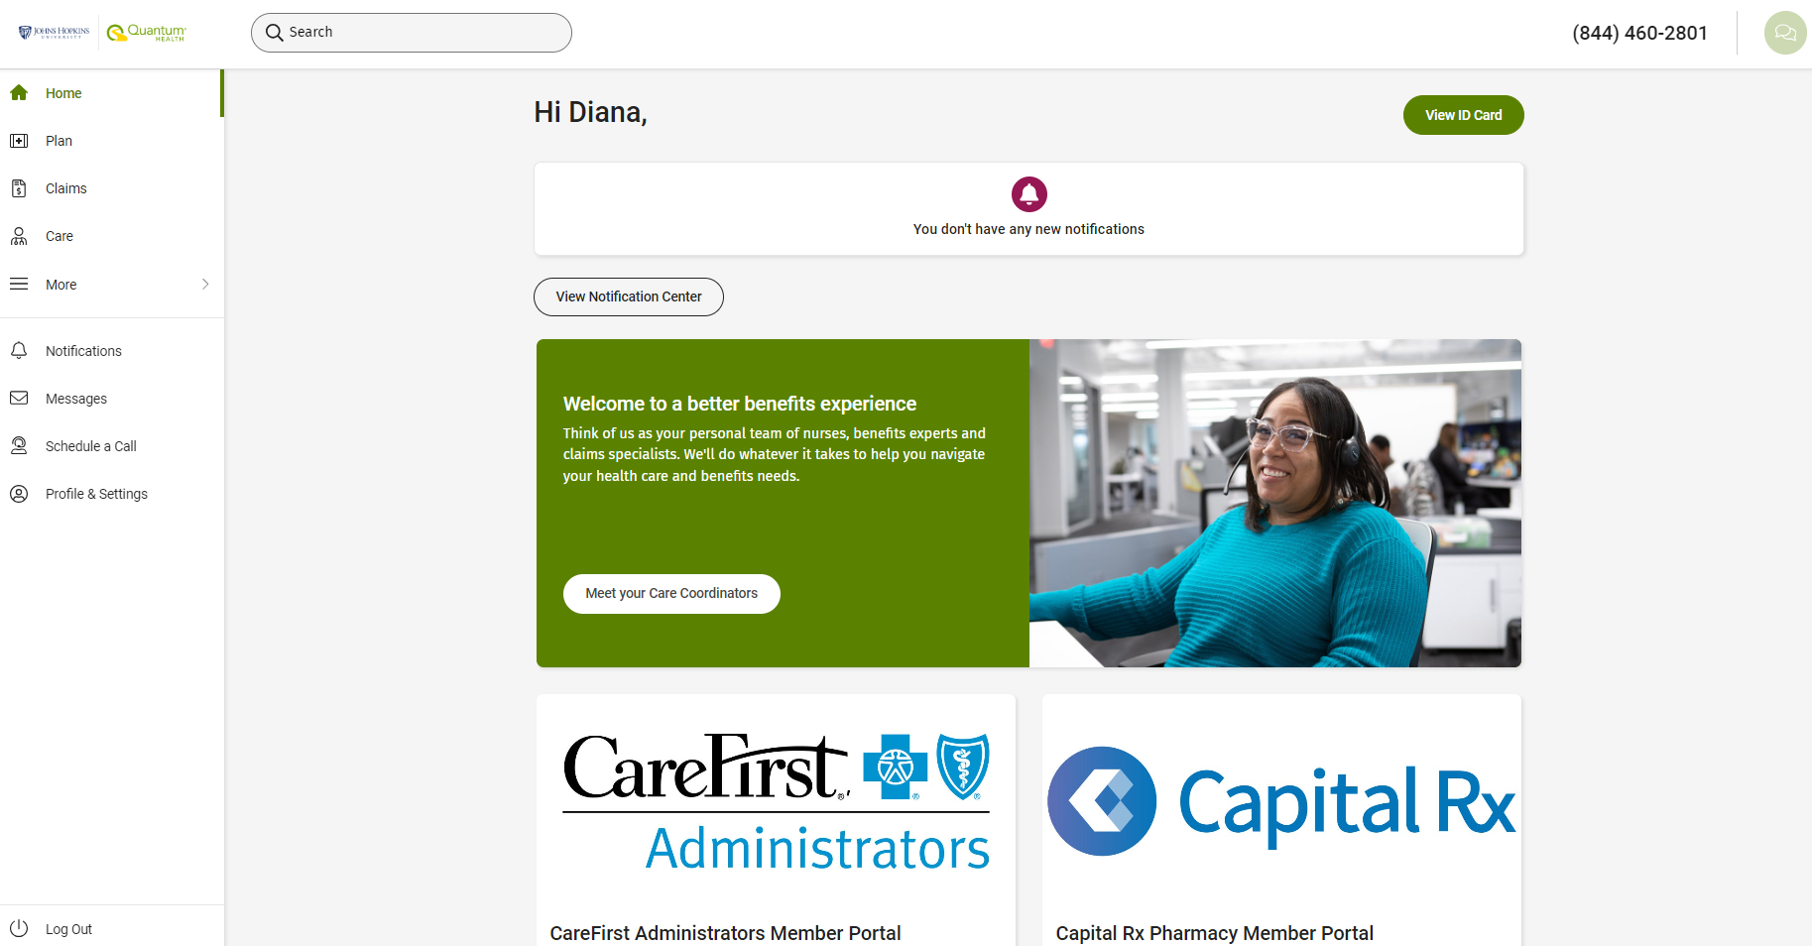
New Member Website – Quantum Health
Pull a copy of your ID card
Search for in-network providers
Chat with a care coordinator
View your medical claims and deductible statuses
Can log in 4/1
Direct Access from Quantum to CareFirst and Capital Rx

Slide 13
Next Steps and Where to go for Help
You do not need to complete any type of enrollment form
Your premiums will be updated with WEX and you should continue to pay as you normally do
Starting April 1, make sure to start to use your NEW ID Card and update your ID Number with all doctors and pharmacies
Contact Quantum Health starting March 15th for any questions on your medical or pharmacy plans 844-460-2801
Other Questions? Contact the Benefits Service Center:
benefits@jhu.edu or 410-516-2000

Slide 14
Thank you!

