Slide 1

Johns Hopkins University
Notes:
Thank you for joining us today to cover your company’s sponsored Commuter plan. This presentation is being presented by WEX. We are the Commuter administrator for [Client Name]
Today, we will be discussing the two Commuter options we have. First, we will be going through our standard debit card process. Following, we will go through our SmartCommute program which is an option for anyone who is located in San Francisco, Washington DC, Chicago, or Atlanta.

Slide 2
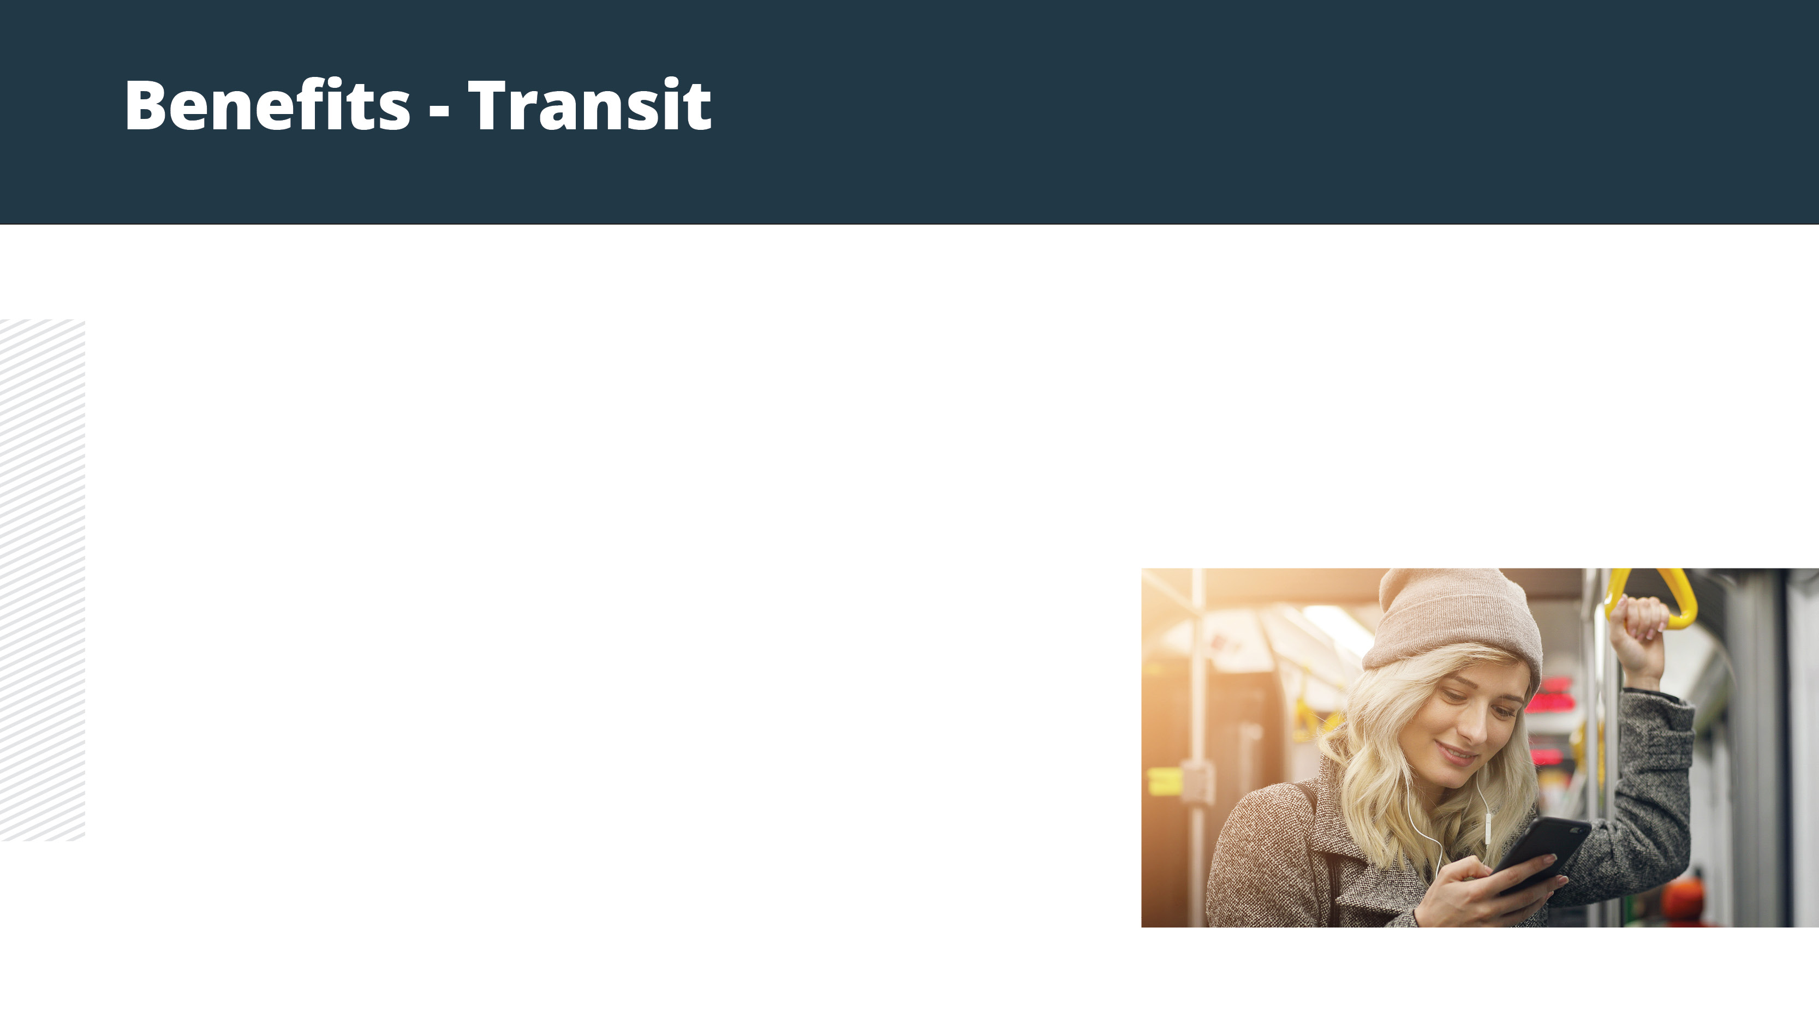
Pay for transportation to and from work – tax-free
Contribute up to $270 a month (pre-tax)
Make post-tax contributions at any time
Public transportation such as train, bus, subway, vanpool (vehicle that seats six or more adults, excluding the driver), ferry, etc.
  UberPOOL
  Lyft Shared
Notes:
Why should you choose Commuter Benefits?
Commuter Benefits allow you to put money from your paycheck aside each month, before taxes are taken out, for qualified mass transit and parking expenses.
You’ll experience fast savings, you can save 40% or more on your costs commuting to and from work.
You’ll also get hours back in your day, the average one way commute to work is nearly 30 minutes! By using public transit, you can use that time to read news, text friends or get a start on your day.
Studies have also shown that people who commuter to and from work in a method other than a private vehicle are less stressed
Enrolling in the commuter plan also makes an impact on the environment, doing your part to reduce traffic congestion & air pollution.

Slide 3
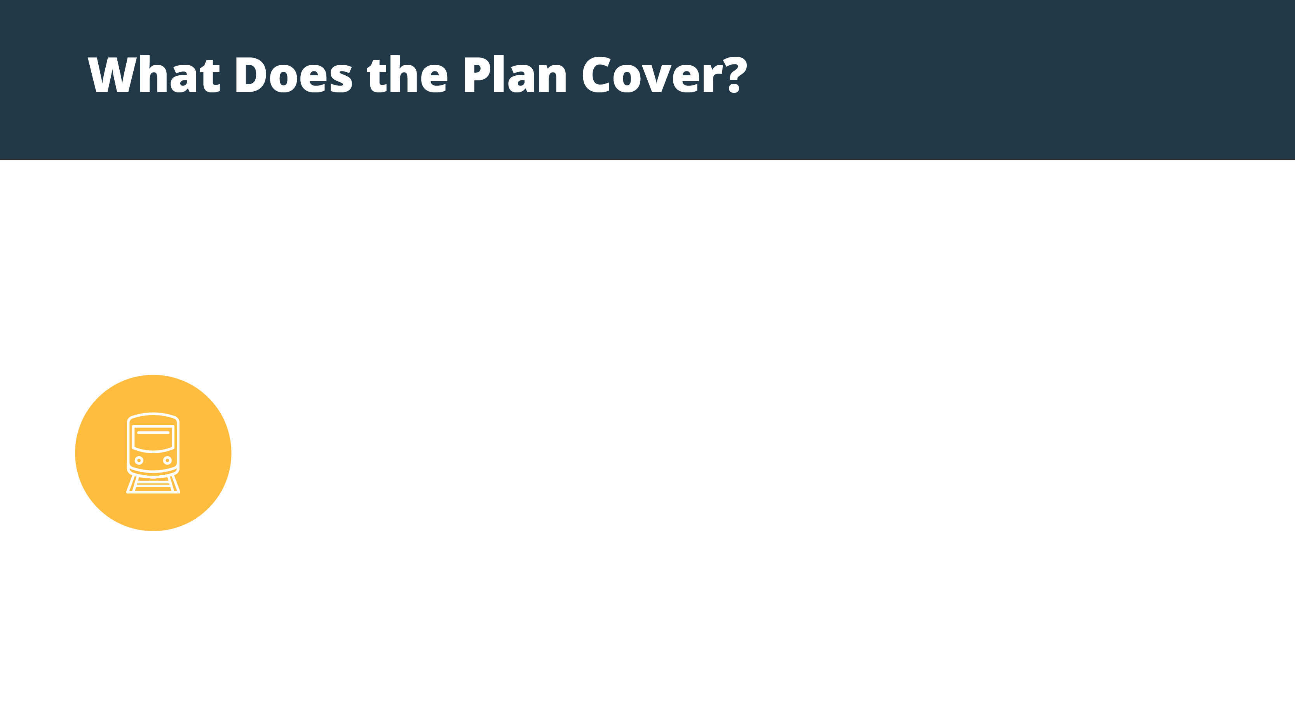
Eligible modes of transportation include but aren’t limited to:
Train
Bus
Subway
Ferry
Vanpool (must seat at least 6 adults)
Parking or parking meter near your place of employment
Notes:
What does the commuter plan cover?
Commuter funds can be used on a variety of transportation and parking expenses that allow you to travel to and from work and your mode. Eligible modes of transportation include but aren’t limited to:
Train
Bus
Subway
Ferry
Vanpool (must seat at least 6 adults)
Parking or parking meter near your place of employment

Slide 4
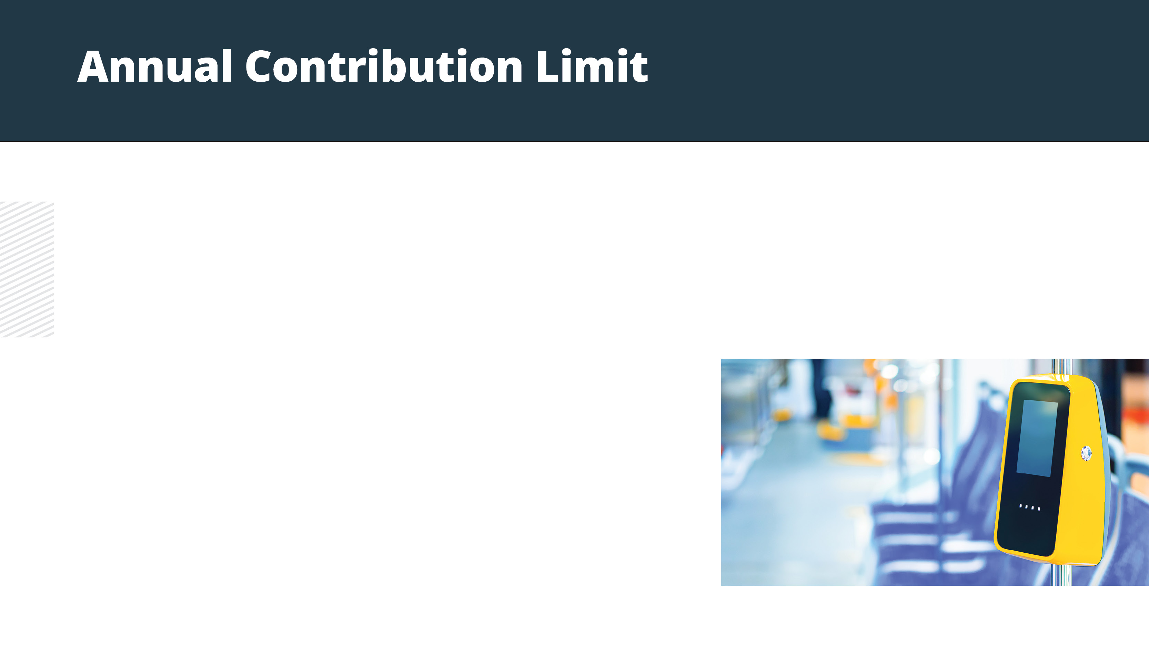
2021 Commuter Benefit Maximum per Month:
Transit- $270 Parking- $270
Any money contributed to your transit or parking benefit rolls over every month until it is used or you are no longer eligible.
Notes:
The IRS sets the maximum dollar amount you can elect and contribute to the commuter and parking plans.
The 2021 limit is $270 per month per-tax for both the transit and parking benefits. Note, these are two separate benefits so you can contribute up to $270 pre-tax into each transit and parking.
We recommend reviewing how much you spend on eligible expenses every year to determine how much to elect.
One great thing to note about the Commuter benefit is that your unused funds will rollover every month until they used or you are no longer eligible.

Slide 5
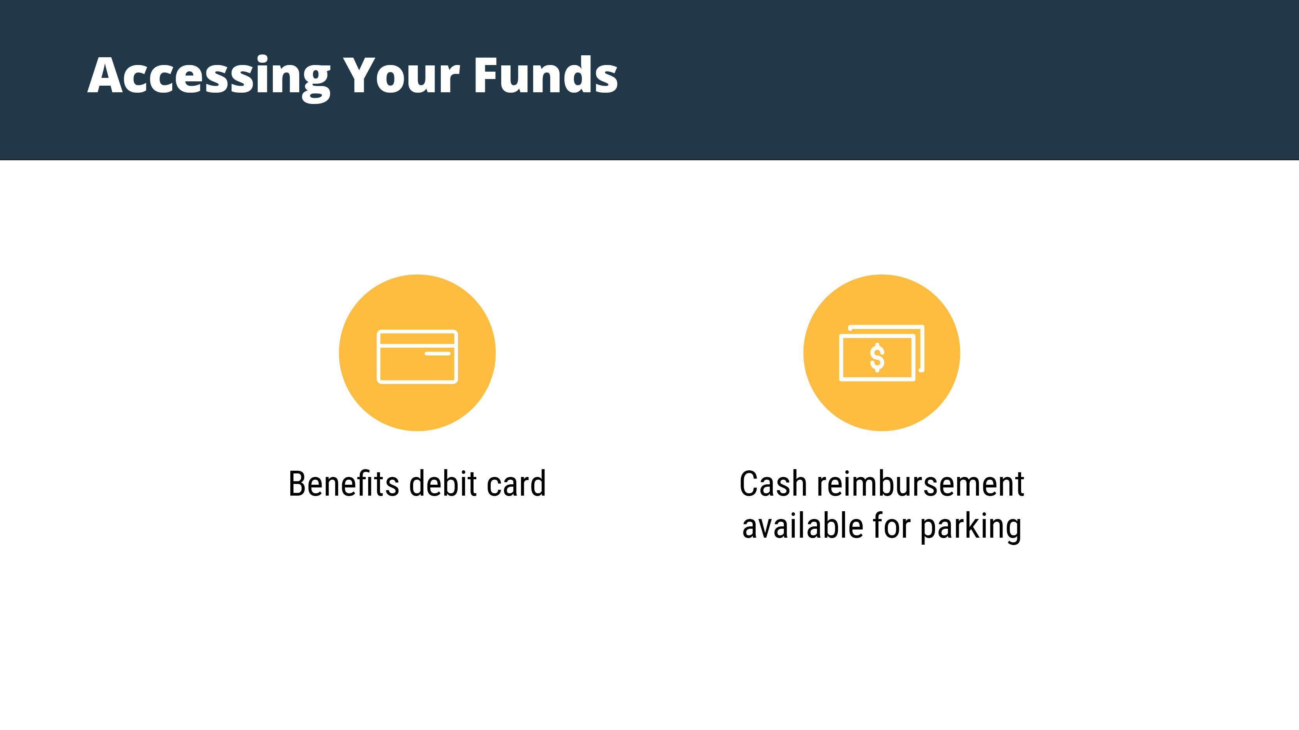
File the parking claims through your online account or mobile app
No documentation required
Notes:
Transit and parking services can be purchased with your benefits debit card at your transit authority or through the “Pay the Provider” option on the participant portal. Cash reimbursement is available for parking only. To do so, you can file a claim online through the participant portal or your mobile app. No documentation is required to file a claim.

Slide 6

Notes:
Our SmartCommute program lets those in the Washington, D.C., Chicago, Atlanta and San Francisco areas load funds directly onto their SmarTrip®, Ventra, Breeze, and Clipper cards. Once that’s completed, simply swipe the transit card at the transit authority to pay for qualifying commuter expenses.

Slide 7
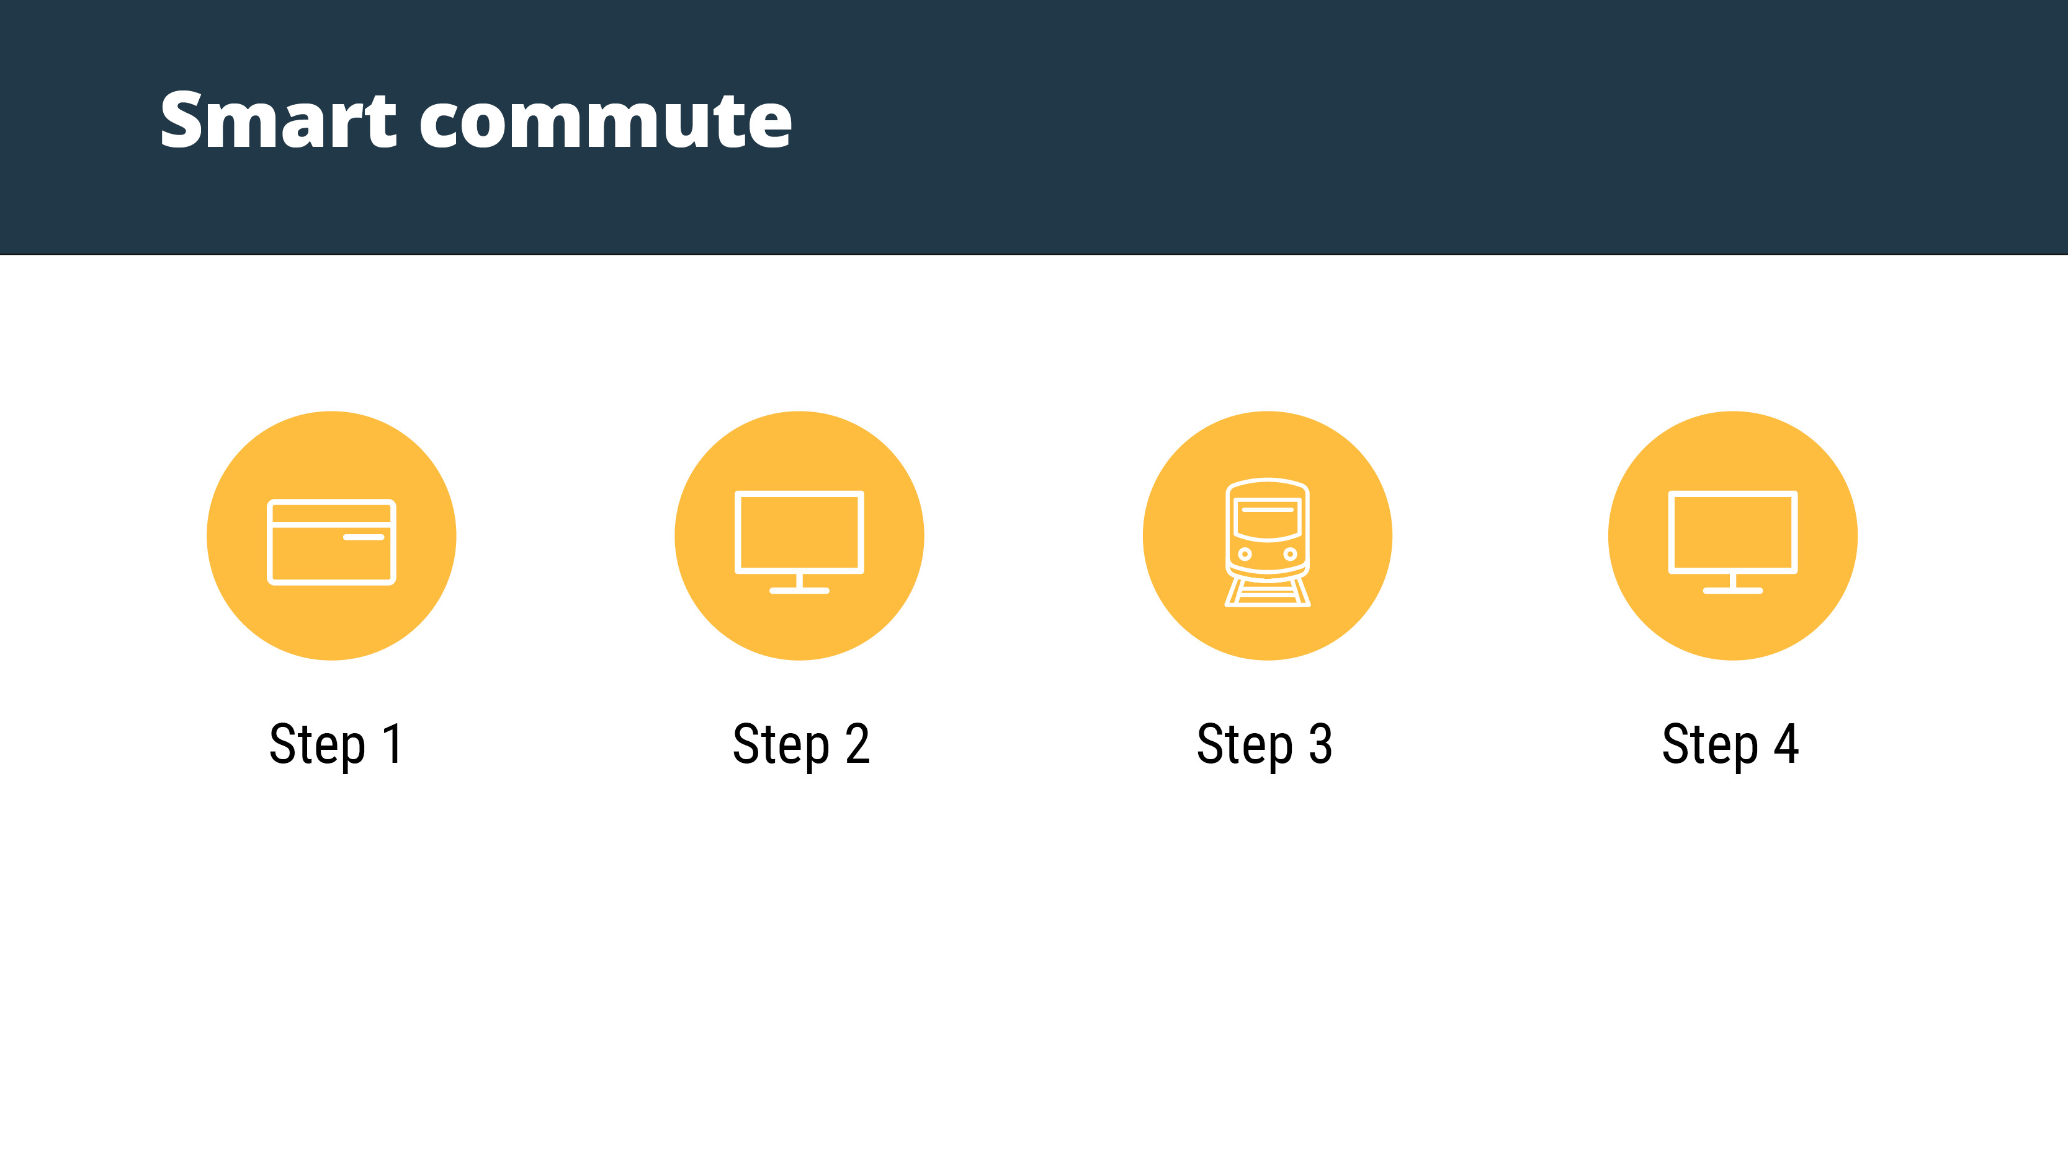
For those in Chicago, San Francisco and Washington D.C.
Enroll in mass transit plan.
Purchase a smart card from you transit authority in Atlanta*, Chicago, San Francisco or Washington D.C.
Log in to your WEX online account, go to the commuter page and load your pre-tax dollars
onto your smart card by clicking “New Order”. You must do this at least a
month in advance.
Pre-tax dollars are available on the smart card on the 1st of the benefit month. You can begin spending!
*Not required for Atlanta; the smart card will be mailed to consumer after the first Smart Commute order is placed
Notes:
Those eligible for Smart Commute can load commuter funds onto transit cards through a commuter page in their WEX online account each month. It’s easy! Just click the “Place Commuter Order” button to access SmartCommute, click the “New Order” button and follow a few simple steps.
SmartCommute orders must be placed by 11:59 p.m. Eastern time on the 10th of the month prior to the balance being used for commuter funds to be accessible on your transit cards. If this deadline isn’t met, funds won’t be loaded onto transit cards.
In Washington DC, you will need to utilize the SmartCommute program if you want to load your commuter funds on your SmarTrip card. The benefits debit card will not work at transit stations in Washington DC to load funds from your transit benefit onto your SmarTrip card. You are still able to utilize the benefits debit card for parking related expenses.

Slide 8
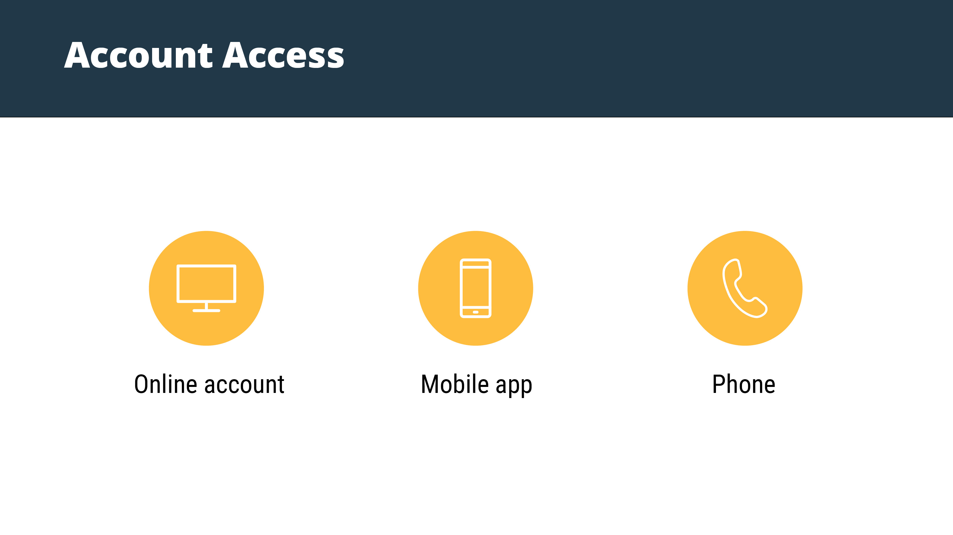
Notes:
WEX offers you many options to access specific account information for your benefits. Any time day or night, you can go to wexinc.com, use your mobile app or call our toll free number for account information. From your online portal, you can check balances, submit claims, check pending reimbursements and enroll in free direct deposit.
It’s easy to stay in touch with your accounts with the WEX mobile app. It’s secure and SIMPLE! Just download the app on your Android, iPhone, or iPad and you are instantly in touch with your balance, contributions and claim activity. Requesting reimbursement has never been easier with mobile app claim filing. You can also set up text alerts, so we can contact you quickly when we receive your reimbursement request.
Lastly, you can call our toll free number to receive balance information.

Slide 9
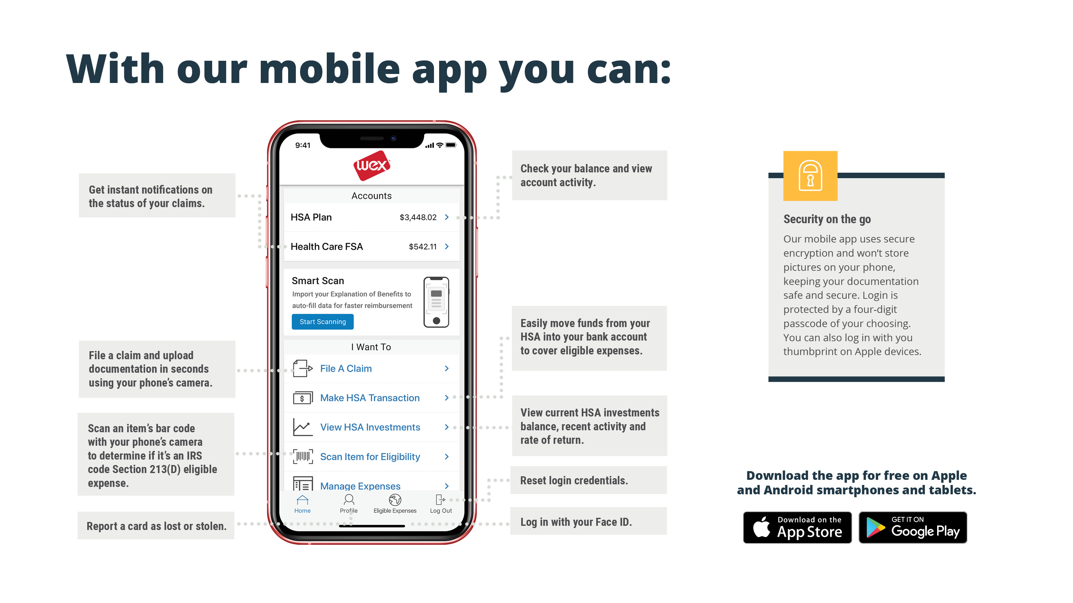
Notes:
The WEX mobile app provides you with quick easy access to your online account. After logging in the first time, you can set up fingerprint or face recognition access right from your phone.
This mobile app is a convenient way to file claims or to see your available balance on the go.

Slide 10
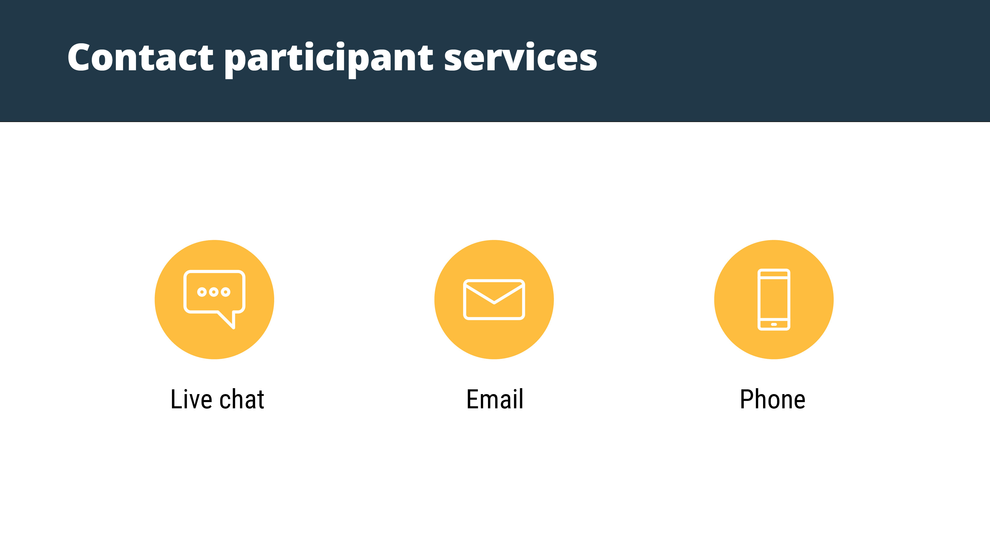
Our Participant Services team is available Monday through Friday, from 6 a.m. to 9 p.m. CT, except holidays.
^{customerservice@wexhealth.com}
⁸⁶⁶⁻⁴⁵¹⁻³³⁹⁹
Notes:
At WEX, we take pride in being helpful and knowledgeable. WEXs’ customer service team is available from 6 a.m. – 9 p.m. Central time Monday – Friday, with the exception of holidays, to assist with any questions you may have on your account. Live chat via your online account during these hours, give us a call at 866-451-3399 or reach us via email at customerservice@wexhealth.com.

Slide 11

Notes:
I want to thank you for taking the time to be with us today.
We hope you found this presentation both educational and enjoyable.
Thank you once again.

